Slide 1
Proning and daily care in mechanical ventilation

Slide 2
Learning objectives
To understand the technique, benefit and contraindications of proning
To understand the COVID-ICU Nursing care

Slide 3
Proning
PRONING is the process of turning a patient with precise, safe motions, from their back onto their abdomen (stomach), so the individual is lying face down.
Benefits of proning
Proning is a medically accepted position to improves breathin comfort and oxygenation.
It is extremely beneficial in COVID-19 patients with compromise breathing comfort, especially during home isolation.
Ministry of Health & Family Welfare Government of India

Slide 4
Importance of prone lying
Prone positioning improves ventilation, keeps alveolar unit open and breathing easy.
Proning is required only when the patient feels difficulty I breathing and the SpO2 decreases below 94 (less than 94).
Regular monitoring of SpO2, along with other signs lik temperature, blood pressure and blood sugar, is important during home isolation.
Missing out on hypoxia (compromised Oxygen circulation) may lead to worsening of complications.
Timely proning and maintaining good ventilation could save many lives.

Slide 5
Positioning of pillow
One pillow below the neck
One or two pillows below the chest through upper thighs
Two pillows below the shins

Slide 6
Caution
Avoid proning for an hour after meals
Maintain proning for only as much times as easily tolerable
One may prone for up to 16 hours a day, in multiple cycles, as felt comfortable
Pillows may be adjusted slightly to alter pressure areas and for comfort
Keep a track of any pressure sores or injuries, especially , around bony prominences
Avoid Proning in conditions like
Pregnancy
Deep venous thrombosis (Treated in less than 48 hours)
Major cardiac conditions
Unstable spine, femur, or pelvic fractures

Slide 7
Avoid Proning in conditions like
Five-step method to place a patient in the prone position using a regular bed, flat sheet, and family members
Using a flat sheet, pull the patient to one side of the bed.
Place the flat sheet around the arm that will pull through (the side you are turning toward).
A second flat sheet is placed on the bed and tucked under the patient. This sheet will pull through as you are turning the patient.
Using the sheet, turn the patient over and position the patient prone. The arm and sheet will pull across the bed.
Pull and center the patient. Discard the sheet that was used to place the patient in the supine position. Straighten lines and tubes.

Slide 8
FAST HUGS BID
F-Feeding/fluid
A-Analgesia
S-Sensorium / Sedation
T-Thrombo-embolic prophylaxis
H-Head up position
U-Ulcer prophylaxis
G- Glycemic control
S-Supplement O2 / Spontaneous breathing trail
B-Bowel care
I-Indwelling catheter
D-Drug de-escalation

Slide 9
Feeding
Feeding is provided to meet the nutritive demands of the patients in ICU
Methods
  Enteral: To be start as soon as possible within the 24-48 hrs after stabilization nasogastric or orogastric tubes [NG/OG]
  Parental
    It Should be considered if a patient has not been able to receive enteral nutrition for at least 7 days.
    Can be delivered via central venous access using Total Parental nutrition solutions (TPN).
Fast I/V infusion of TPN can lead to hyperglycemia

Slide 10
Nursing care
Head end should be elevated about 30 to 45 degree to prevent aspiration
Checking and fixation of tube
Tolerating
After giving feed flush with normal water, to prevent any blockages

Slide 11
Analgesia
Analgesia can lead to unwanted prolonged endo-tracheal intubation.
Benefits of analgesia
  Optimizes patient comfort.
  Minimizes the acute stress response (hyper metabolism, increased oxygen consumption).
The patient may experience pain due to
  Illness
  Devices (ET Intubation)
  Procedures (Ryles Tube, Suctioning)

Slide 12
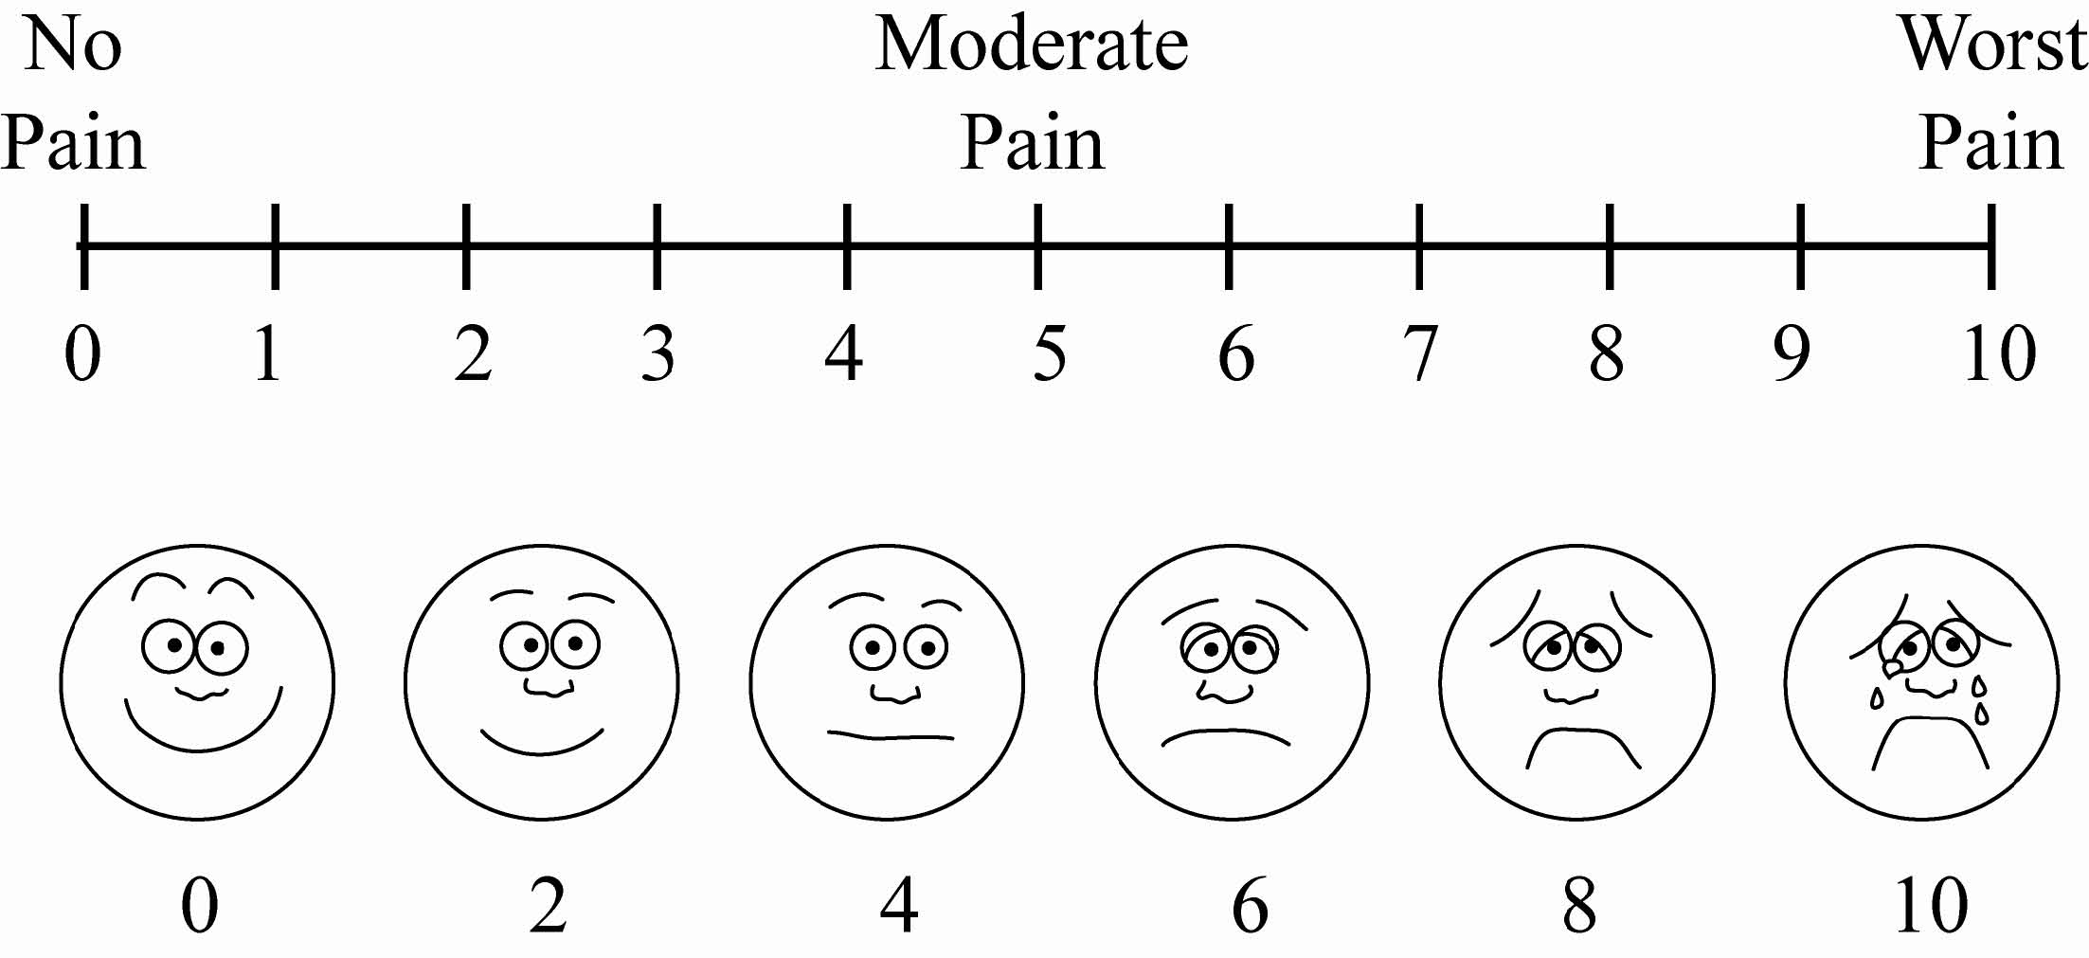
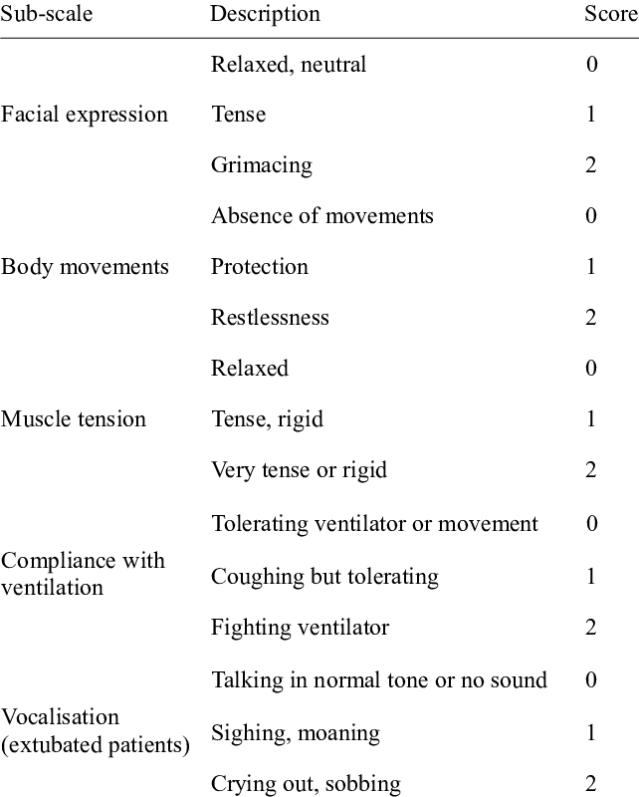
Nurse’s role
Pain should be assessed regularly with:
1. VISUAL ANALOGUE SCALE
2. CRITICAL CARE PAIN OBSERVATION TOOL

Slide 13
Sedation
Benefits of sedation
  Control agitation
  Prevent accidental extubation
  Control intra-cranial pressure and reduce metabolic rate
Over-sedating causes
  Respiratory depression and hypotension.
  Prolonged ventilation leads to nosocomial infection.

Slide 14
Nursing care
Ensure intubated patients have adequate depth of sedation with calm, comfortable and collaborative level.
Evaluate depth of sedation-by Glasgow coma scale(GCS).
Richmond agitation and sedation scale (RASS) for intubated patients

Slide 15
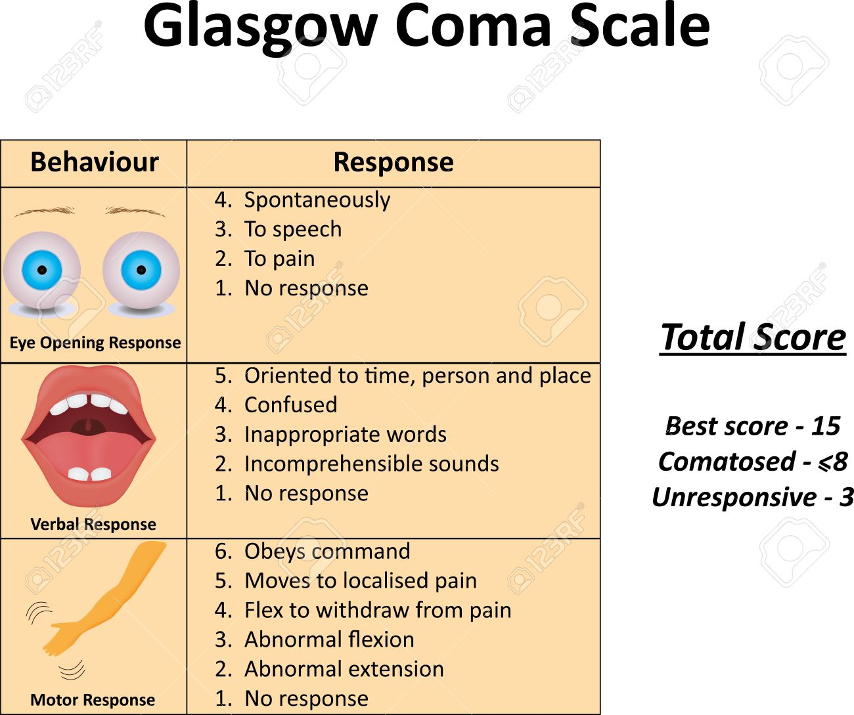
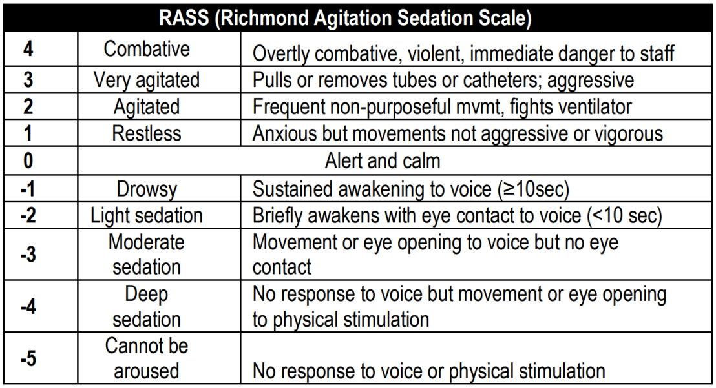
Assessment of sedation
1. Glasgow Coma Scale
2. RASS(Richmond Agitation Sedation Scale)

Slide 16
Thrombo-embolic prophylaxis
Prolonged stay of intubated or bed ridden patients in ICU can leads to thrombo-embolism.
Need
  To prevent Deep vein thrombosis(DVT)
  Pulmonary embolism (PE)
  It should be implemented as soon as possible within the first 24 hours following admission as it increases the risk of venous thrombo-embolism (VTE)
Nursing care
Graduate compression stockings or intermittent pneumatic compression devices (IPC)
Thigh length elasticized compression stockings (ECS)
Sequential compression devices (SCD).
Pharmacological agents such as: clexane, low dose heparin.

Slide 17
Head up position
Issues with elevated head
  Aspiration.
  Ventilator associated pneumonia(VAP)
Elevate the head of bed to 30-45 degree angle
Benefits
  reduces the occurrence of gastro-intestinal reflux
  prevents changes of aspiration during enteral feeding and nosocomial pneumonia
  avoid increase in INTRA CRANIAL PRESSURE (ICP) in head injured patients
Nursing care
Ensuring head of bed is elevated at least 30 to 45 degree (head injured patients should have HEAD-OF-BED elevated to 30 degree as tolerated), unless it is contraindicated

Slide 18
Ulcer prophylaxis
Issues due to ulcers
  Mucosal damage
  Significant bleeding. Incidence of gastrointestinal bleeding ranges from 1.5 to 8.5% and may reach 15% in patients without prophylaxis
Benefits of ulcer prophylaxis
  Prevent gastrointestinal bleeding.
  prevent stress ulcers in ICU
Avoidance of ulcer prophylaxis leads to complications as follows:
Nursing care
Ensure patient is receiving a form of stress ulcer prophylaxis
histamine-2 receptor blockers
Proton pump inhibitors, sucralfate
Minor
Sepsis Prolonged stays in ICU Occult GI bleeding for 6 or more days’ Glucocorticoid therapy Any organ transplant
Major
Mechanical ventilation>48hrs Coagulopathy (platelets<50,000), (INR>1.5) Traumatic brain injury, spinal cord or burn injury

Slide 19
Glycaemic control
Nursing care
Problem statement
  Insulin deficiency is associated with diabetic ketoacidosis.
  Hyperglycemia and hypoglycemia can increase mortality, length of stay, and infection in ICU patients.
Benefits of glycemic control
  Fasten wound healing
  Reduced infection rate
  Reduced risk of poly neuropathy
Ensure adequate pharmacologic glucose control.
Are glucose level at goal? (ICU patients goals <180mg/dl)
Prior history of diabetes (Type I, Type II)
Evaluate changes in diet (will insulin to be modified)

Slide 20
Spontaneous breathing trial/supplement oxygen
Nursing care
Prolonged intubation can lead to breathing related issues patients
Benefits
  Positive pressure type of ventilation
  Reduced prolonged length of ICU stays
  When patient need further ventilator care or if planned for extubation, a trial of T-PIECE is given before weaning
Monitor saturation level of patients and assess for signs of cyanosis
Oxygen support by face mask/nasal prongs according to the saturation of oxygen of patient

Slide 21
Bowel care
Nursing care
Issues related with bowel
  Diarrhea can lead to electrolyte imbalances.
  Dehydration.
  Constipation.
Dos
  Encourage to take liquids
  Provide suppositories and enema, if required
  Perform abdominal message
Look for abdominal distension
Auscultation for presence of bowel sounds
Palpate for tenderness, tightness, tightness/rigidity.
Observe any mucous or blood present in the stool
Document passing flatus, bowels open and quantity/nature of faces

Slide 22
Indwelling catheter
Nursing care
Indwelling catheter can lead to nosocomial infections or complications like
  Catheter associated urinary tract infection(CAUTI)
  Central line association bloodstream infection(CLEBSI)
Benefit
  Removal of all lines as soon as possible to prevent nosocomial infection such as peripheral, arterial, central, etc.
Day of indwelling catheter should be checked to prevent nosocomial infection. Site should be assessed for any abnormal sign like – redness, swelling etc.
Foleys catheter should be changed after 7 days

Slide 23
Drug de-escalation
Problem statement
  High amount of dose
  higher level antibiotic usage
Interventions
  Change from the broad spectrum antibiotic to an agent with a narrow focus based on culture data
  Focus from multiple antibiotics to a single drug
  When the suspected organism is detected by culture reduce overload of antibiotics dosages.
Nursing care
Watching out for discontinuation of antibiotics or changing in to a less narrow spectrum antibiotics is almost because as antibiotics use promotes development of resistance.

Slide 24
Benefits of FAST HUGS BID
Improves quality of patient care
Increases safety and efficiency of patient care
Helps not to forget general aspects of patient care.
It encourages teamwork

Slide 25
Key messages
Fast I/V infusion of TPN can lead to hyperglycemia
Analgesia can lead to unwanted prolonged endo-tracheal intubation.
Performing FASTHUGSBID
  Encourages teamwork & in improving the quality of care
  Ensures safe, effective and efficient care.
  Provides interventions to reduce errors of omission
  Increase compliance with evidence-based practices to improve outcomes of effective nursing care.

