Slide 1
Acute pancreatitis in Covid-19–
A Therapeutic dilemma
Dr. Akhil V P
Junior Resident, Academic
Department of Anaesthesiology
AIIMS Patna
Notes:
COVID-19 patients with GI symptoms(N = 31)COVID-19 patients without GI symptoms(N = 119) No gastrointestinal symptoms 119 (79.3)

Slide 2
Introduction:
Clinical presentation of Covid-19 pandemic is vivid.
Gastrointestinal symptoms are less common as compared to respiratory symptoms(>59%) in covid-19, but it may be fatal if presents as pancreatitis.*
* Evidence for Gastrointestinal Infection of SARS-CoV-2 Fei Xiao etal
Gastroenterology, 2020-05-01, Volume 158, Issue 6, Pages 1831-1833.e3, Copyright © 2020 AGA Institute

Slide 3
Presentation – AIIMS Patna
A 63-year-old man otherwise normal, came to flu clinic- AIIMS Patna with a positive SARS CoV-2 rapid antigen test Report, complaining of abdominal pain and breathing difficulty for 5 days.

Slide 4
Pain was epigastric and associated with nausea and vomiting.
Patient was not having any h/o alcohol intake, hypertriglyceridemia,
hypercalcemia, smoking, gall stone or abdominal surgeries.
Breathing difficulty
No other relevant past or family history

Slide 5
Presentation – AIIMS Patna
Patient was afebrile, maintaing oxygen saturation on nasal prongs with stable vitals.
HR 100/Minute
BP 136/94 mmHg
RR 24/Minute
Temp 98F
Spo2 91—96%

Slide 6
The physical examination of the patient was showed jaundice, nondistended, soft abdomen with epigastric discomfort on palpation. No palpable mass.
Patient was admitted in Covid ward on 25/08/2020.

Slide 7
Day 1- Ward
All blood routine investigations including
  Covid panel, Blood and Urine culture for sensitivity was send after admission.
Patient was treated with analgesics (Tramadol+Paracetamol)
Antibiotics Amoxicillin + Clavulenic Acid, Metronidazole
and vitamins with zinc.
Patient orally allowed
Vitals monitored and charted

Slide 8
Haemoglobin | 9.4
WBC | 13.24
Platelet Count | 73
RBC Count | 4.05
PCV | 27.5
Neutrophils | 67.3
Lymphocytes | 29.2
Total Bilirubin | 13.51
Direct Bilirubin | 5.72
Indirect Bilirubin | 7.79
ALT/SGPT | 324.3
AST/SGOT | 389.7
ALP | 315.8
Total Protein | 6.37
Albumin | 2.85
Globulin | 3.52
A/G Ratio | 0.81
Notes:
Serum ferritin, LDH, IL-6, Bilirubin, AST, ALT, were elevated with a high leucocyte count and serum procalcitonin.

Slide 9
Serum Urea | 32.2
Creatinine | 1.03
Uric Acid | 4
Serum Calcium | 7.84
Phosphorus | 4.11
Sodium | 128.67
Potassium | 4.67
Chloride | 97.72
Blood group B+ve
APTT | 39.64
PT | 14.08
INR | 1.05
RANDOM GLUCOSE | 149
d dimer | 6.7 ug/ml
PROCALCITONIN | 1.38 ng/ml
CRP Quantitative | 134.98 mg/l
LDH | 1490 U/L
ferritin | 775 80.31 5.4
Interleukin6
HbA1C (Whole Blood)

Slide 10
Ultrasound abdomen done - shows mild hepatosplenomegaly with mild ascites and pleural effusion.
Chest x-ray showed bilateral opacities.

Slide 11
DAY 2/ WARD
Antibiotics were escalated to piperacillin tazobactum due to elevated serum Procalcitonin
Plan for d Remdesvir put on hold due to deranged LFT , and convalescent plasma requisition given.
CECT abdomen done on day 2

Slide 12
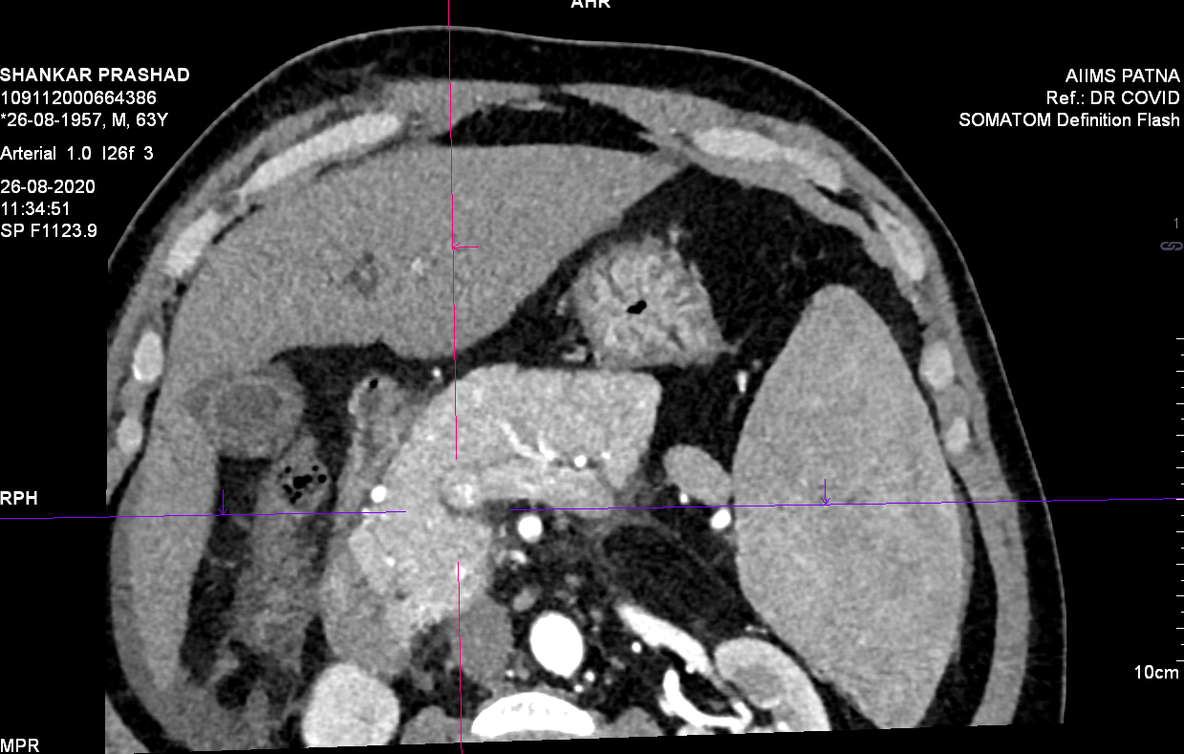
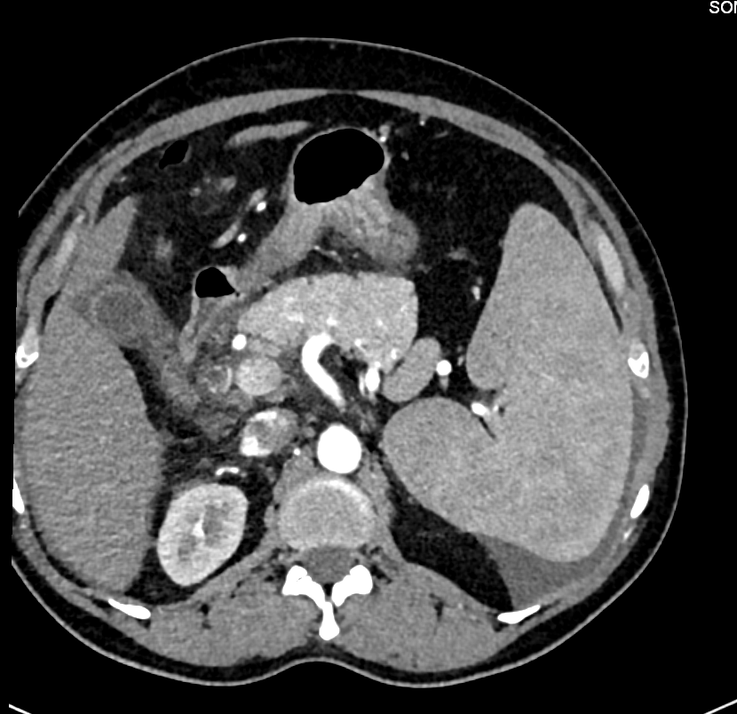
Contrast enhanced CT done on day 2, results s/o acute interstitial pancreatitis and covid pneumonia (CORADS- 6)

Slide 13
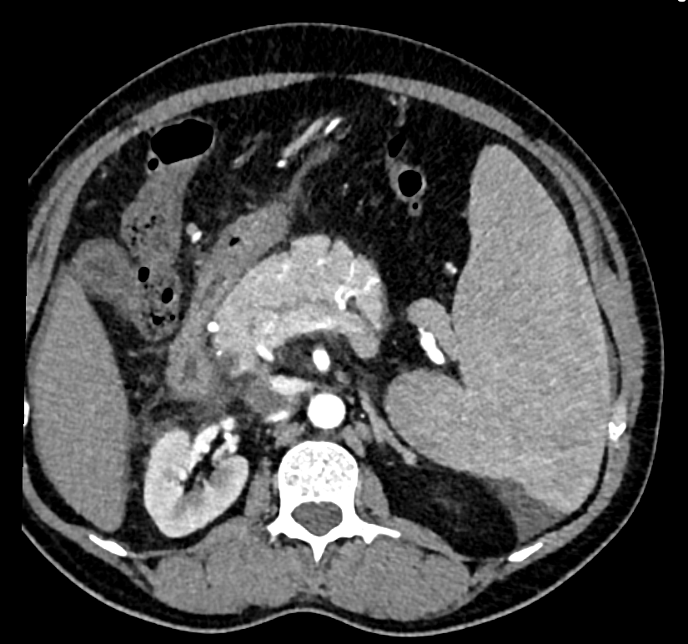
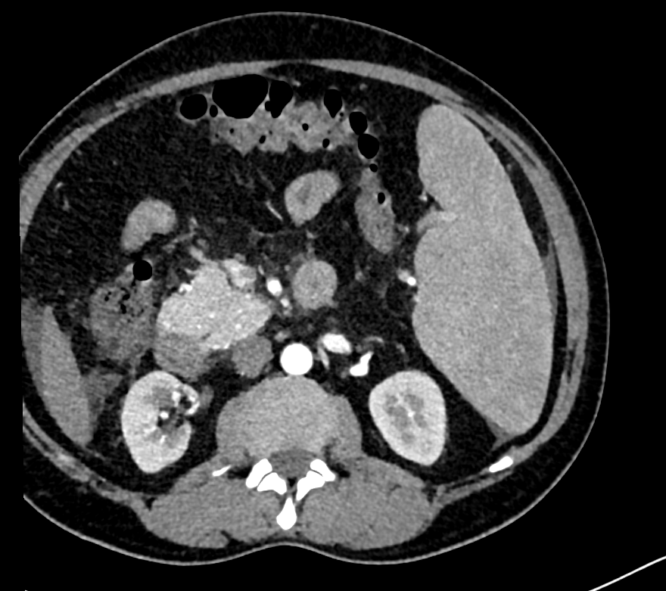
Mild diffusely enlarged pancreas with peripancreatic fat stranding, s/o acute interstitial edematous pancreatitis.

Slide 14
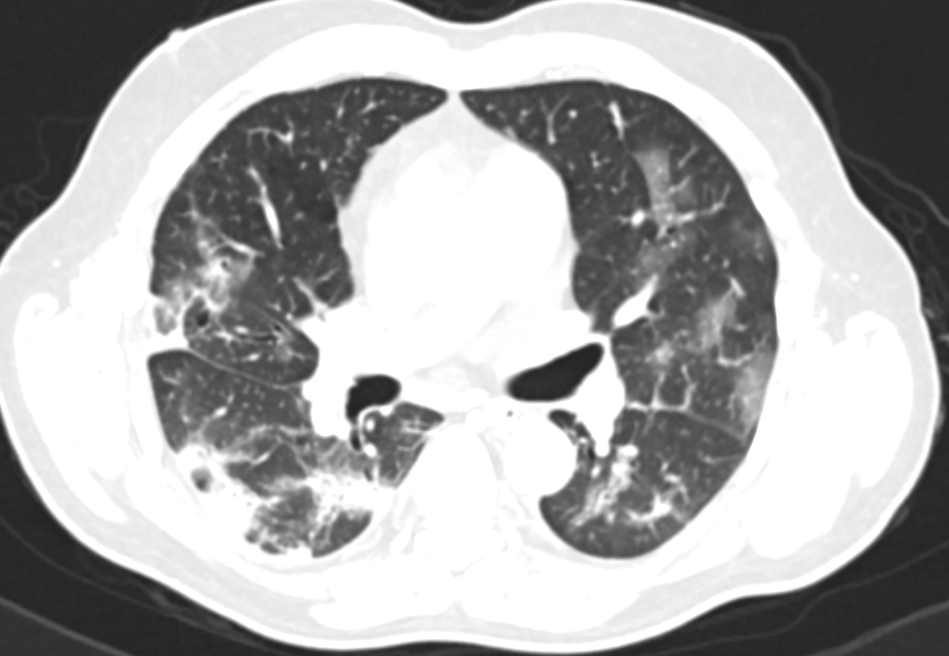
Multifocal patches of discrete and confluent ground glass opacities and consolidation within apicobasal and anteroposterior gradient in b/l lung parenchyma

Slide 15
Gastro medicine consultation given and hepatoprotective drugs added. Plan for ascetic fluid study with hold due to minimal fluid status.
Patient was shifted to ICU on 3rd day as requirement of oxygen has increased
Spo2 was not maintaining on Nasal prongs or Facemask <88%
Patient was put on NRM mask 15 l/min

Slide 16
DAY 3/ WARD-ICU
Patient was not maintaining Spo2 on NRM 15L /min
ABG was send
Patient was shifted to ICU for further ventilator management
In ICU patient was received investigations send as per ICU Protocol.
All routine investigations , Covid panel, Culture were repeated

Slide 18
ICU DAY 3-6
In ICU patient was treated with intermittent NIV and NRM.
NIV PS , PEEP -6 to 10 ,PS 12-15 Fio2 60 -100%
IV fluids – Balanced Salt Solution according to dynamic parameters
Nasogastric tube inserted feeding started after calculating caloric and protein requirements
Foleys catheter inserted for urine output monitoring.
Hyponatremia and hyperkalaemia corrected.
Dexamethasone 6mg started as once daily usage.

Slide 19
 | 25-08-2020 | 28-08-2020 | 29-08-2020 | 30-08-2020
Haemoglobin | 9.4 | 8.7 | 8.5 | 9.2
WBC | 13.24 | 18.62 | 20.66 | 21.86
Platelet Count | 73 | 80 | 123 | 150
RBC Count | 4.05 | 3.7 | 3.59 | 3.91
PCV | 27.5 | 25.7 | 25.1 | 28
Neutrophils | 67.3 | 90.6 | 93.6 | 93.6
Lymphocytes | 29.2 | 8.6 | 4.9 | 5.3
Total Bilirubin | 13.51 | 11.3 | 7.35 | 5.96
Direct Bilirubin | 5.72 | 4.76 | 2.91 | 2.48
Indirect Bilirubin | 7.79 | 6.54 | 4.44 | 3.48
ALT/SGPT | 324.3 | 170.2 | 125.8 | 92.4
AST/SGOT | 389.7 | 183 | 160.7 | 115.4
ALP | 315.8 | 401.8 | 335.5 | 313.1
Total Protein | 6.37 | 7.09 | 7.12 | 6.74
Albumin | 2.85 | 2.86 | 2.91 | 2.76
Even though LFT was getting improved with in period with a decrease in bilirubin level to 6mg/dl from 13mg/dl, total leucocyte count increased so along with piperacillin tazobactum, clindamycin added.

Slide 20
25-08-2020 | 28-08-2020 | 29-08-2020 | 30-08-2020
Serum Urea | 32.2 | 37.9 | 44.7 | 57.4
Creatinine | 1.03 | 0.81 | 0.74 | 0.81
Uric Acid | 4 | 2.42 | 3.87 | 2.79
Serum Calcium | 7.84 | 7.36 | 7.35 | 7.86
Phosphorus | 4.11 | 3.78 | 4.44 | 3.65
Sodium | 128.67 | 127.6 | 124.02 | 133.87
Potassium | 4.67 | 5.32 | 6.08 | 5.58
Chloride | 97.72 | 95.3 | 96.06 | 105.01
d dimer(ug/ml) | 7.2
PROCALCITONIN(ng/ml) | 1.8
CRP Quantitative (mg/l) | 150.32
LDH (U/L) | 1250
ferritin | 850
Interleukin6 | 60
(APTT) | 39.64 | 40.01
PT | 14.08 | 13.08
INR | 1.05 | 0.97
RANDOM GLUCOSE | 149
Amylase U/L | 149.25 | 136.96
Serum Lipase | 165.73 | 131

Slide 21
 | 27-08-2020 | 28-08-2020 | 28-08-2020 | 29-08-2020 | 30-08-2020
pH | 7.48 | 7.46 | 7.47 | 7.54 | 7.43
pCO2 | 28.5 | 22 | 20 | 18 | 27.4
pO2 | 66.3 | 66.9 | 72 | 173 | 97
HCO3 | 21 | 15.9 | 15.4 | 15.9 | 19
Lac | 1.4 | 1.9 | 1.2 | 3.7 | 1.8
SO2 | 94.5 | 94.6 | 95.5 | 99 | 98
Patient was improving interms of oxygenation

Slide 22
On day 5 (29/8/2020) morning patient was put on invasive ventilation due to severe ARDS.
In due course patient required inotropic support with noradrenaline.
However patient succumbed on 6th day due to respiratory failure.

Slide 23
Discussion
Pancreatitis is an inflammatory process in which pancreatic enzymes auto digest the gland. Many causes of pancreatitis are established including alcoholism, gallstones, trauma, surgical manipulations, metabolic derangements.
It has been reported acute inflammation in the pancreas due human immunodeficiency virus, mumps, Cytomegalovirus, Coxsackievirus B and Influenza A (H1N1) Epstein-Barr Virus¹
1. P.G. Lankisch, M. Apte, P.A. BanksSupplementary appendix: acute pancreatitis
Lancet, 6736 (2015), pp. 1-32

Slide 24
In SARS-CoV infection (2003), the virus was detected in lung, liver, kidney, intestine and the pancreas, indicating the pancreas as a potential coronaviral target².
A case-series of 52 COVID-19 patients reported that pancreatic injury was present in 17% of patients³.
Pathogenesis of COVID-19 is mediated by angiotensin-converting enzyme-2 (ACE-2) receptor on cells⁴. ACE-2 receptors are highly expressed in the pancreatic islets. This may be the reason for acute pancreatitis in our case.
2. Ding Y., et. al.: Organ distribution SARS‐CoV in SARS patients: implications for pathogenesis and virus transmission pathwaysOrgan distribution SARS‐CoV in SARS patients
J Pathol 2004; 203: pp. 622-630.
3 Evidence for Gastrointestinal Infection of SARS-CoV-2 Fei Xiao etal
Gastroenterology, 2020-05-01, Volume 158, Issue 6, Pages 1831-1833.e3, Copyright © 2020 AGA Institute
4 Ni, W., Yang, X., Yang, D. et al. Role of angiotensin-converting enzyme 2 (ACE2) in COVID-19. Crit Care 24, 422 (2020). https://doi.org/10.1186/s13054-020-03120-0

Slide 25
Treatment of acute pancreatitis is mainly supportive. Hydration, pain management, infection control and treatment of metabolic complications is the key in management^{5,6}.
In severe acute pancreatitis medical management are to provide aggressive supportive care, to decrease inflammation, to limit infection or super infection, and to identify and treat complications as appropriate^{5,6}.
5 Banks PA, Bollen TL, Dervenis C, et al
Classification of acute pancreatitis—2012: revision of the Atlanta classification and definitions by international consensus Gut 2013;62:102-111.
6 Tenner, Scott etal ⁴ American College of Gastroenterology Guideline: Management of Acute Pancreatitis, American Journal of Gastroenterology: September 2013 - Volume 108 - Issue 9 - p 1400-1415 doi: 10.1038/ajg.2013.218

Slide 26
Some disparity in treatment existed between covid pneumonia and pancreatitis. American College of Gastroenterology (ACG) recommends aggressive hydration, unless this is precluded by cardiovascular and/or renal comorbidities⁶. But in covid pneumonia fluid restrictive strategies are followed. We provided adequate fluids to the patient with BSS by assessing the dynamic parameters.
6 Tenner, Scott etal ⁴ American College of Gastroenterology Guideline: Management of Acute Pancreatitis, American Journal of Gastroenterology: September 2013 - Volume 108 - Issue 9 - p 1400-1415 doi: 10.1038/ajg.2013.218

Slide 27
Even corticosteroids are associated with acute pancreatitis, whereas low dose steroid have beneficial effect on critically ill covid patients.
Acute pancreatitis itself can present as diabetes, and steroids are also diabetogenic .
American Gastroenterological Association (AGA) and ACG are against the usage of prophylactic antibiotics⁶.
These factors made the treatment cumbersome in combined acute pancreatitis and covid 19.
Future studies must address the real impact of pancreatic involvement in COVID-19 patients.
6 Tenner, Scott etal ⁴ American College of Gastroenterology Guideline: Management of Acute Pancreatitis, American Journal of Gastroenterology: September 2013 - Volume 108 - Issue 9 - p 1400-1415 doi: 10.1038/ajg.2013.218

Slide 28
References
1. P.G. Lankisch, M. Apte, P.A. BanksSupplementary appendix: acute pancreatitisLancet, 6736 (2015), pp. 1-32
2 Ding Y., et. al.: Organ distribution SARS‐CoV in SARS patients: implications for pathogenesis and virus transmission pathways Organ distribution SARS‐CoV in SARS patients J Pathol 2004; 203: pp. 622-630.
3 Evidence for Gastrointestinal Infection of SARS-CoV-2 Fei Xiao etal Gastroenterology, 2020-05-01, Volume 158, Issue 6, Pages 1831-1833.e3, Copyright © 2020 AGA Institute
4.Aloysius MM, Thatti A, Gupta A, Sharma N, Bansal P, Goyal H. COVID-19 presenting as acute pancreatitis. Pancreatology. 2020;20(5):1026-1027. doi:10.1016/j.pan.2020.05.003
5. Cheung S., Fuentes A.D., Fetterman A.D. Recurrent acute pancreatitis in a patient with covid-19 infection American Journal of Case Reports, Volume 21, 2020
6. Emerging phenotype of SARS-CoV2 associated pancreatitis. Article in Press: Accepted Peter Szatmary etal, Gastroenterology, Copyright © 2020

