Slide 1
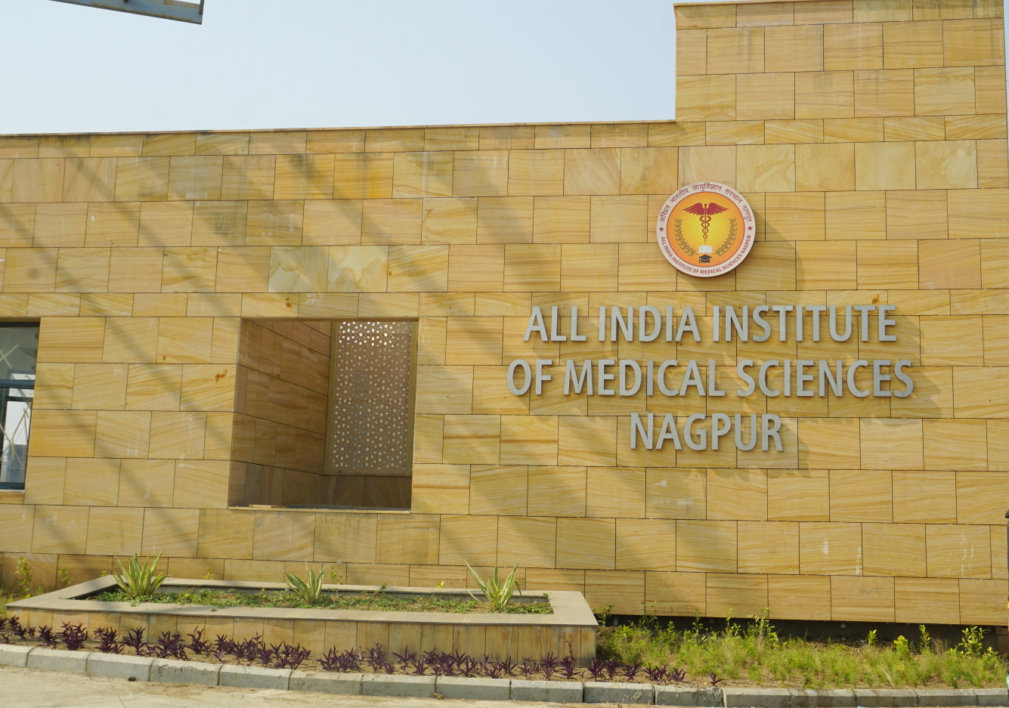
Greetings !!!

Slide 2
Covid 19- An Interesting Case
Guide
Dr P P Joshi, Professor & HOD
Contributors
Dr S D Kumbhalkar, Professor
Dr Amol Dube, Associate Professor
Dr Bharat Rathod, Asst Professor
Dr Anant Pilawan, Asst Professor
Department of General Medicine
Dr Richa Juneja, Haematologist
Dept of Pathology
Presenter
Dr Rajashree Khot
Associate Professor
Department of General Medicine
All India Institute of Medical Sciences
Nagpur

Slide 3
Overview
Introduction
Case presentation
Problems
Discussion

Slide 4
Introduction
Severe COVID-19 - Critical illness - Acute respiratory distress (ARDS) - Multi-organ failure (MOF) as its primary complications, eventually followed by intravascular coagulopathy.
Unique coagulopathy and procoagulant endothelial phenotype.
Systemic hypercoagulability and frequent venous thromboembolic events.
Platelets are at the frontline of COVID-19 pathogenesis
Classically, Mild thrombocytopenia due to increased platelet consumption
Disseminated intravascular coagulopathy (DIC) and severe bleeding events are uncommon in COVID-19 patients.

Slide 5
Clinical History
55 years old , Male patient, Resident of a suburb in Nagpur (Hudkeshwar)
Admitted on 8/11/2020, 11.30 am
Chief complaints ------ Fever – 8 days
Dry Cough – 8 days
Breathlessness – 1 day
Comorbidities – Diabetes Mellitus – 17 years
Hypertension – 8 years
Pulmonary Tuberculosis – 5 years, complete treatment
Non-smoker, Non-Alcoholic, Non-tobacco chewer
No h/o any bleeding in the past
COVID 19 positive
by RT PCR,
1 day before,
CT (N) = 30.22

Slide 6
Exam & Baseline Investigations
Baseline Investigations
Hb%(gms/dl) -12.8
TLC/cu mm - 8490
NLR-- 3.8
Platelets/cu mm - 2,67,000
Sr Bilirubin – 0.85 mg/dl
AST - 192.1 IU/L
ALT - 186.5 IU/L
Sr Creatinine - 1.8 mg/dl
ECG – Normal, Trop I -Neg
Spo2 – 94%
6 min walk test - Spo2 – 90%
Gen exam –-- HR – 98
BP – 130/80
Systemic exam - Normal
Admission blood glucose – 265 mg/dl
(uncontrolled Diabetes) - HbA1c =10.9%
Inflammatory Markers
Sr CRP – 35 mg/L
Sr Ferritin - 975.7 ngm/ml
Sr D- Dimer – 526 ngms/ml
Sr IL6 - 33.8 pgm/ml
Procalcitonin - 0.13 ngm/ml

Slide 7
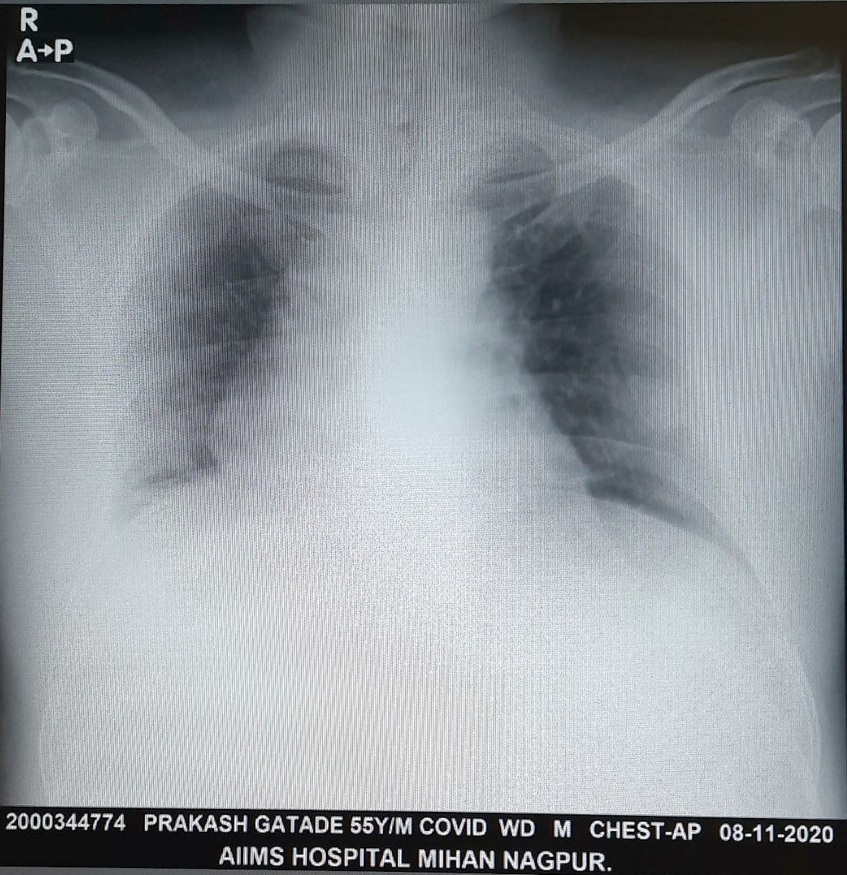
Xray Chest – PA VIEW
Patch of Consolidation
Diagnosis
Systemic Hypertension
Diabetes Mellitus
COVID 19 Moderate Disease
Stage II Group E

Slide 8
Treatment
Tab HCQs 400 mg BD on Day & 400 mg OD Day 2-5
Inj Enoxaparin 40 mg S/C BD
Inj Methylprednisone 40 mg IV OD
Inj Ceftriaxone 1 gm IV BD
Inj Mixtard 30: 70
28 U ---------34 U
Boluses of Rapid Insulin according to blood sugar
Supportive treatment
Remdesivir
Favipiravir
Tocilizumab
Doxycycline
Ivermectin
Azithromycin
Blood Group - A Rh+ve
Convalescent Plasma Therapy Planned
200 ml infused 2nd Day

Slide 9
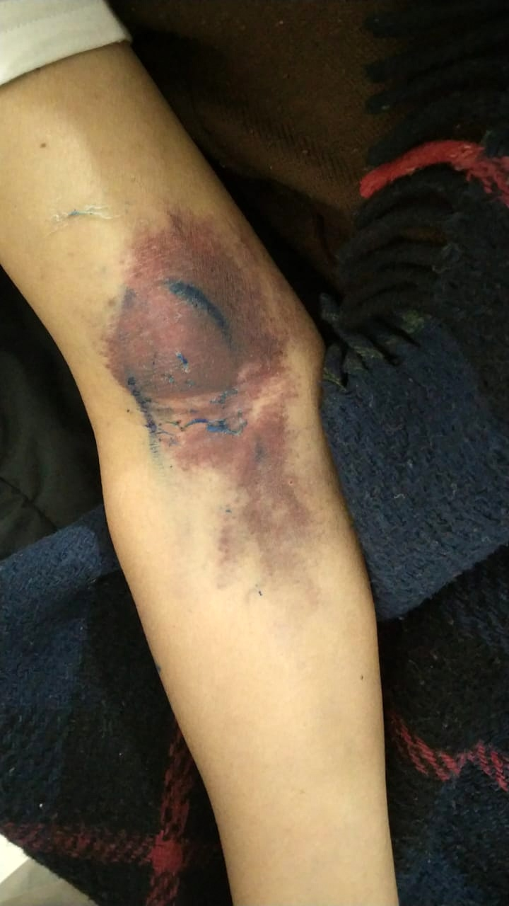
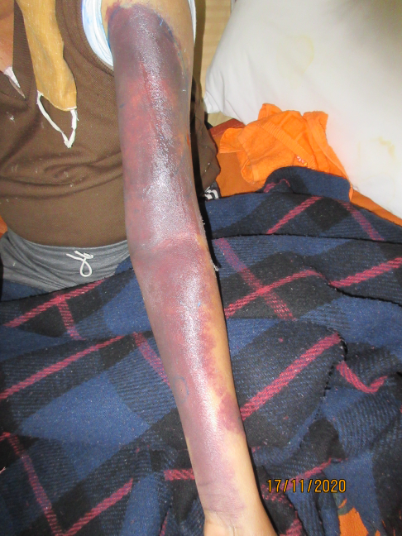
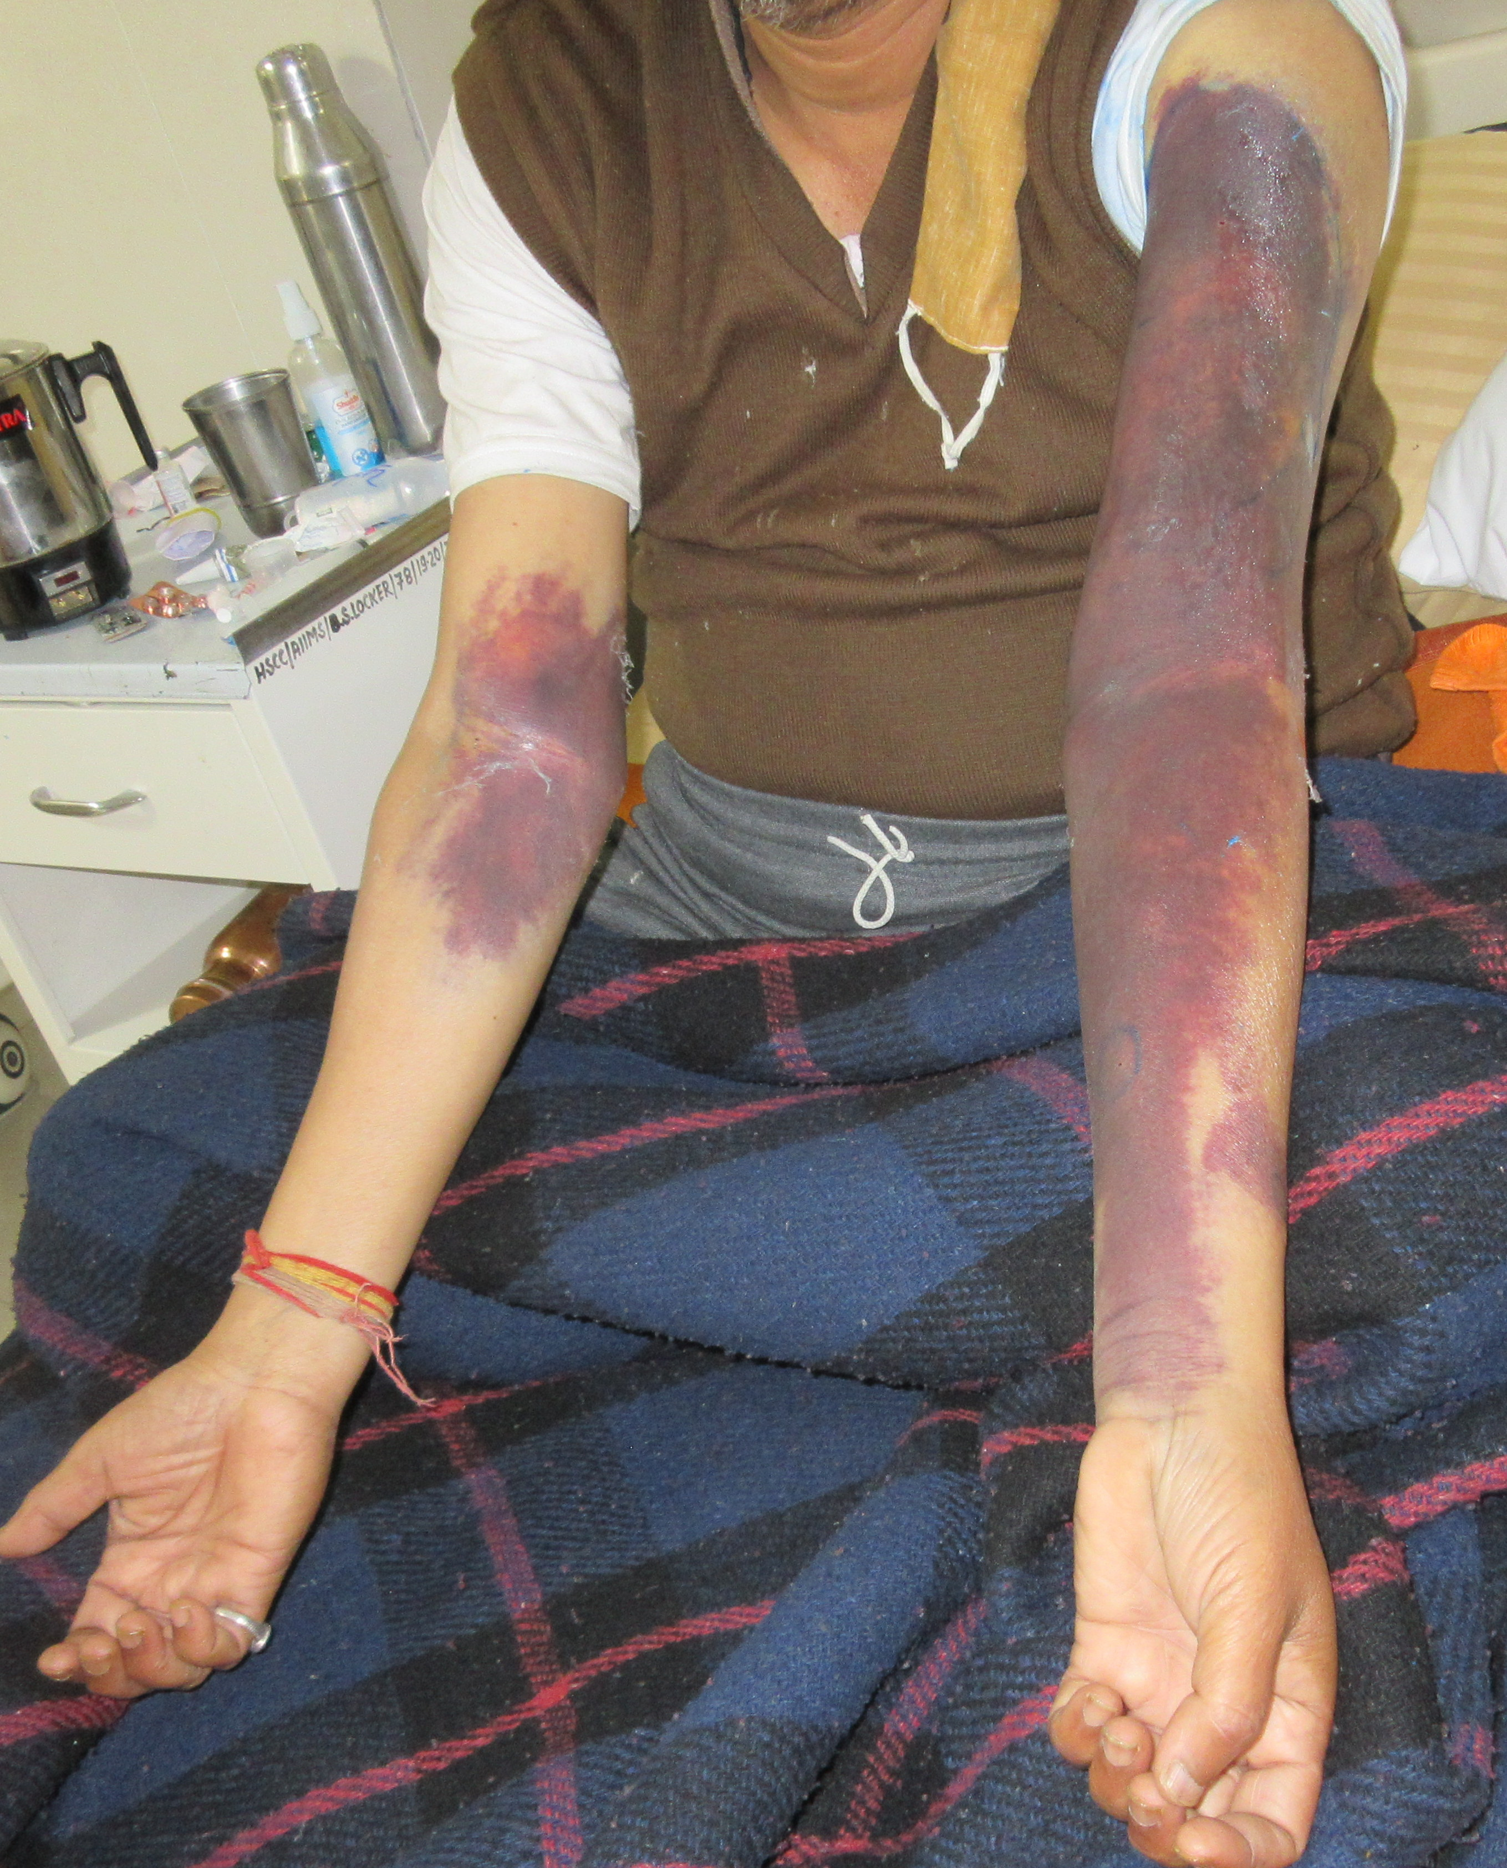
Complication

Slide 10
Differential Diagnosis
Heparin induced Thrombocytopenia
Hepatic Coagulopathy
Drug induced Thrombocytopenia (Cephalosporins)
Sepsis and DIC
COVID 19 related cutaneous bleeding manifestation
Convalescent Plasma related immunologically mediated coagulopathy
Acquired Coagulopathy sec to Infection mediated Factor inhibitors
Familial coagulopathy e.g. Fibrinogen deficiency, Factor XIII deficiency

Slide 11
CBC,Coagulation Profile
Hb% - 13.9
TLC - 13,910
NLR - 5.7
Platelets - 4,10,000
AST - 107.5
ALT - 64.1
Sr Creatinine -2.27
Coagulation Profile
Prothrombin Index – 97.01%
INR = 1
APTT = Pt – 32 sec,
Control – 29 sec

Slide 12
Date Investigations | 09/11 | 11/11 Ecchymosis | 12/11 | 14/11 | 19/11 | 26/11
Hb%(gms/dl) | 12.8 | 13.9 | 12.6 | 10.6 | 10.3 | 12
TLC/cu mm | 8490 | 13,910 | 13,930 | 20,370 | 16,210 | 8390
NLR | 3.8 | 5.7 | 7 | 12 | 9.3 | 2.4
Platelets/cu mm | 2,67,000 | 4,10,000 | 4,36,000 | 6,82,000 | 6,93,000 | 3,95,000
AST | 192.1 | 107.5 | 113 | 48.6 | 35 | 24.2
ALT | 186.5 | 64.1 | 122 | 82.5 | 46.4 | 31.2
Sr Creatinine | 1.8 | 2.27 | 0.96 | 1.56 | 1.23 | 0.90
Sr CRP | 35 |  |  | 22.8 | 11.8
Sr Ferritin | 975.7 |  | 394 | 233 | 149
Sr D- Dimer | 526 |  | 123 | <100
Sr IL-6 | 33.8 |  |  |  | 5.6
Sr Procalcitonin |  | 0.13 ngm/ml
Sr. Bilirubin -0.85 mg/dl
15/11 : 9,49,000

Slide 13
Peripheral Smear
Platelet Function Assay
Von Willebrand Factor Antigen
Factor XIII Deficiency

Slide 14
Blood sugars

Slide 15
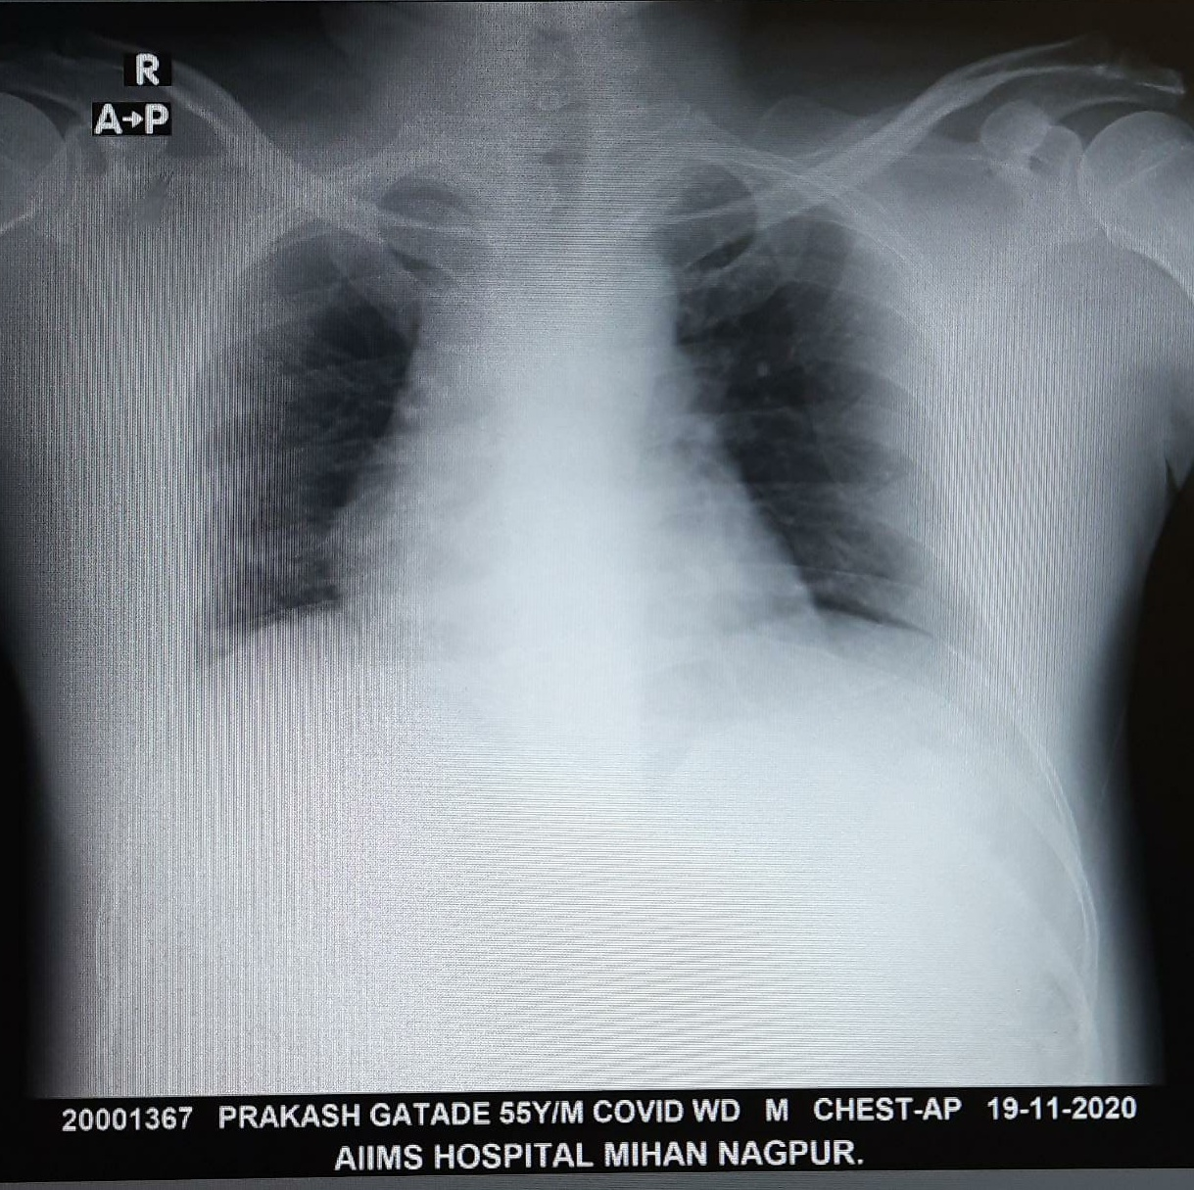
Management
Enoxaparin, Ceftriaxone stopped
Inj Piperacillin Tazobactum 4.5 gms IV 8 hourly
Inj Methylprednisone 40 mg IV BD – Later shifted to Oral prednisone
Insulin infusion
1 unit of Fresh Frozen Plasma was also given on 7th day
Cold compresses and soothing agents – Local treatment
Supportive treatment
8th Day onwards – Clearing of ecchymotic lesions
10th Day - Discharged

Slide 16
Final Diagnosis
Systemic Hypertension
Diabetes Mellitus
COVID 19 Severe disease
? Infection related Reactive thrombocytosis
?? Idiosyncratic Reaction to Convalescent Plasma therapy

Slide 17
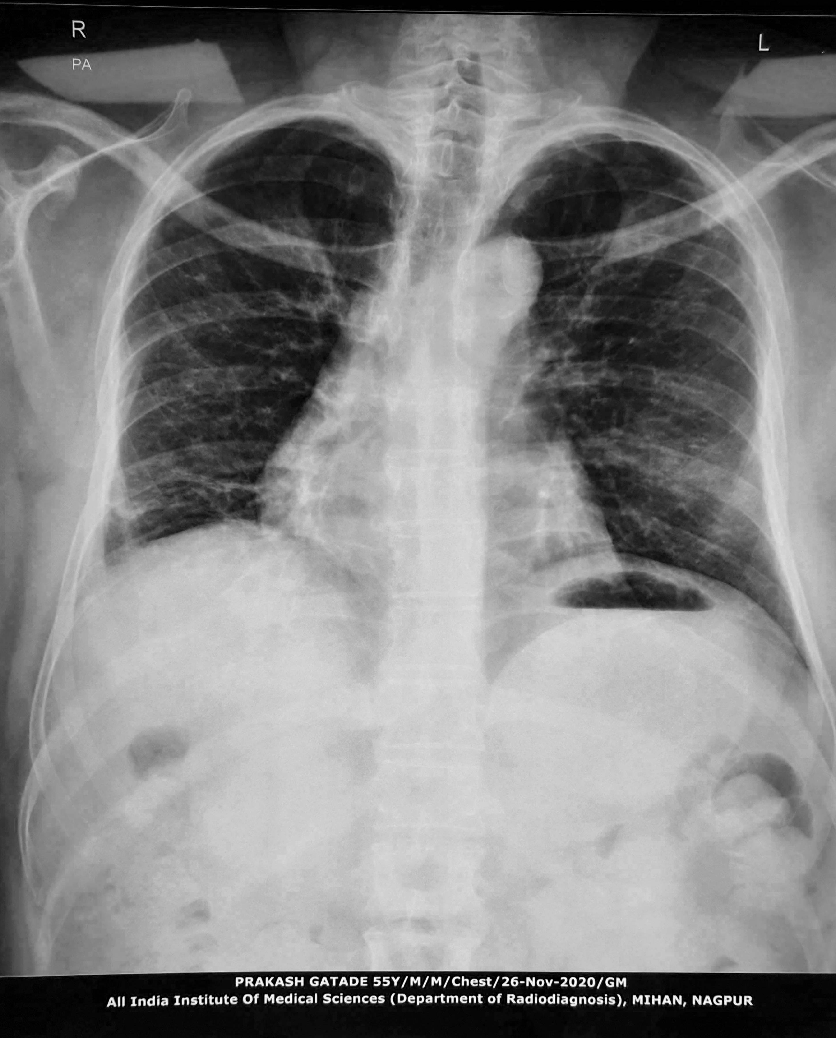
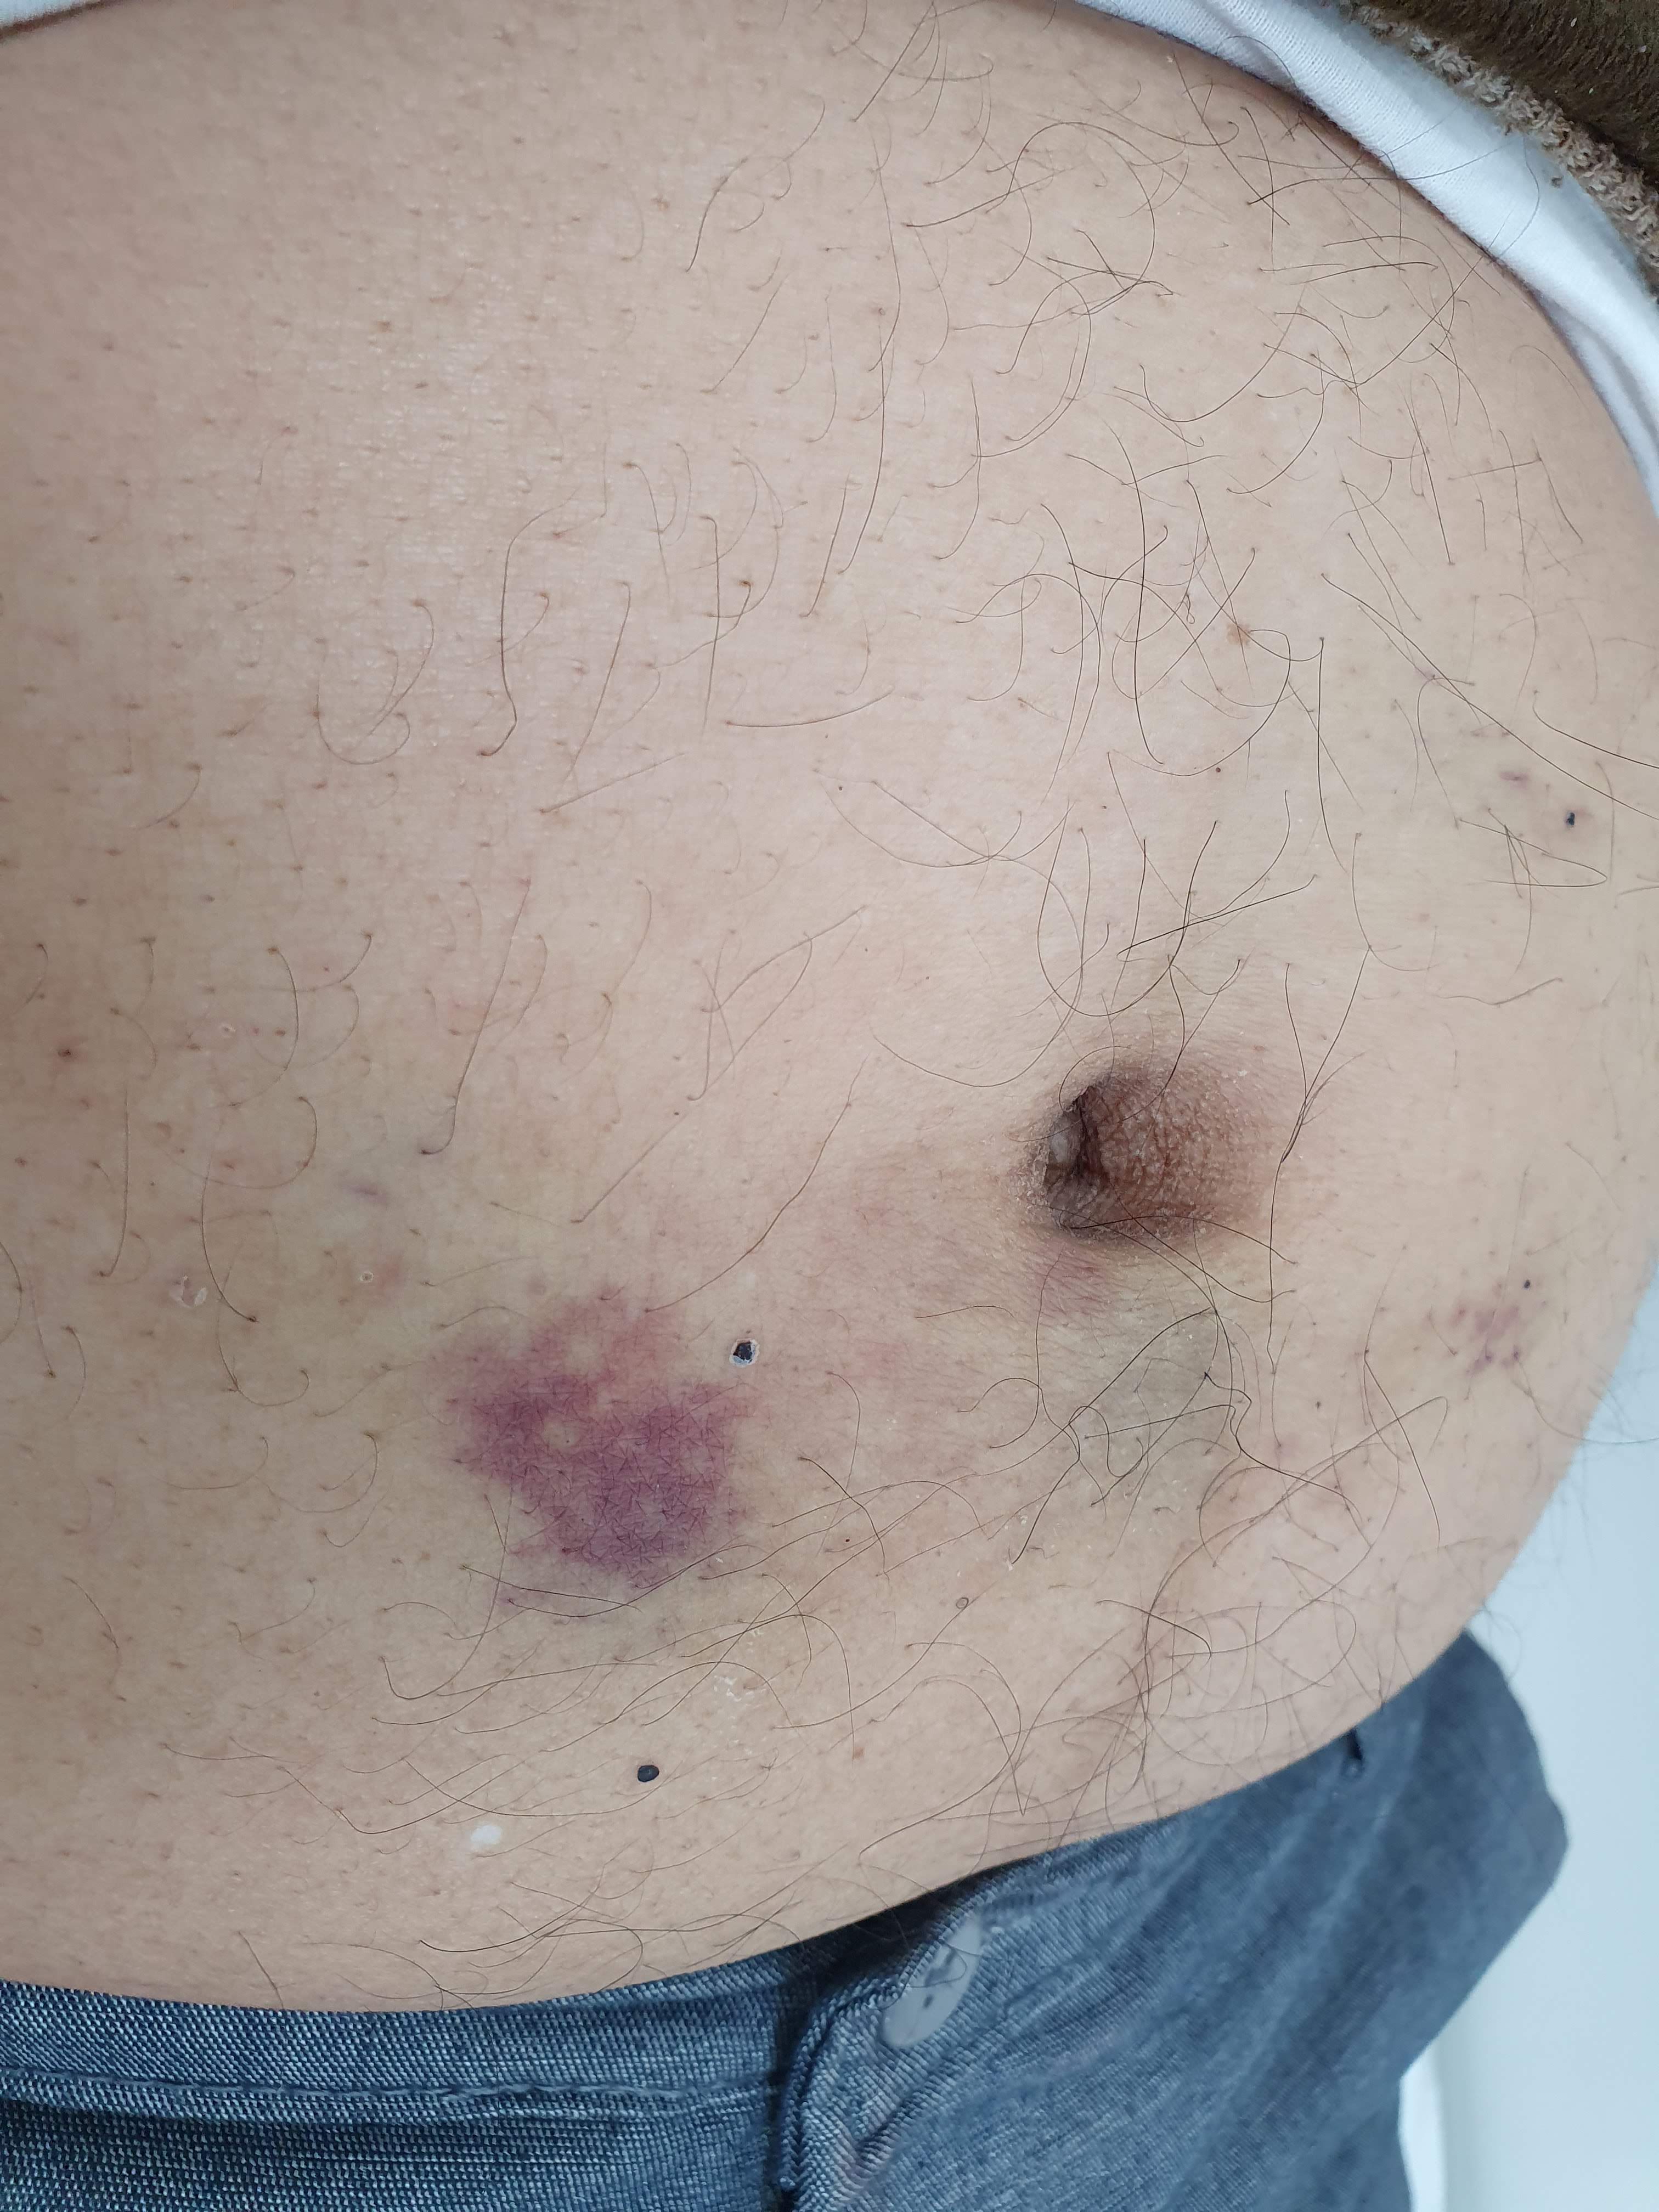
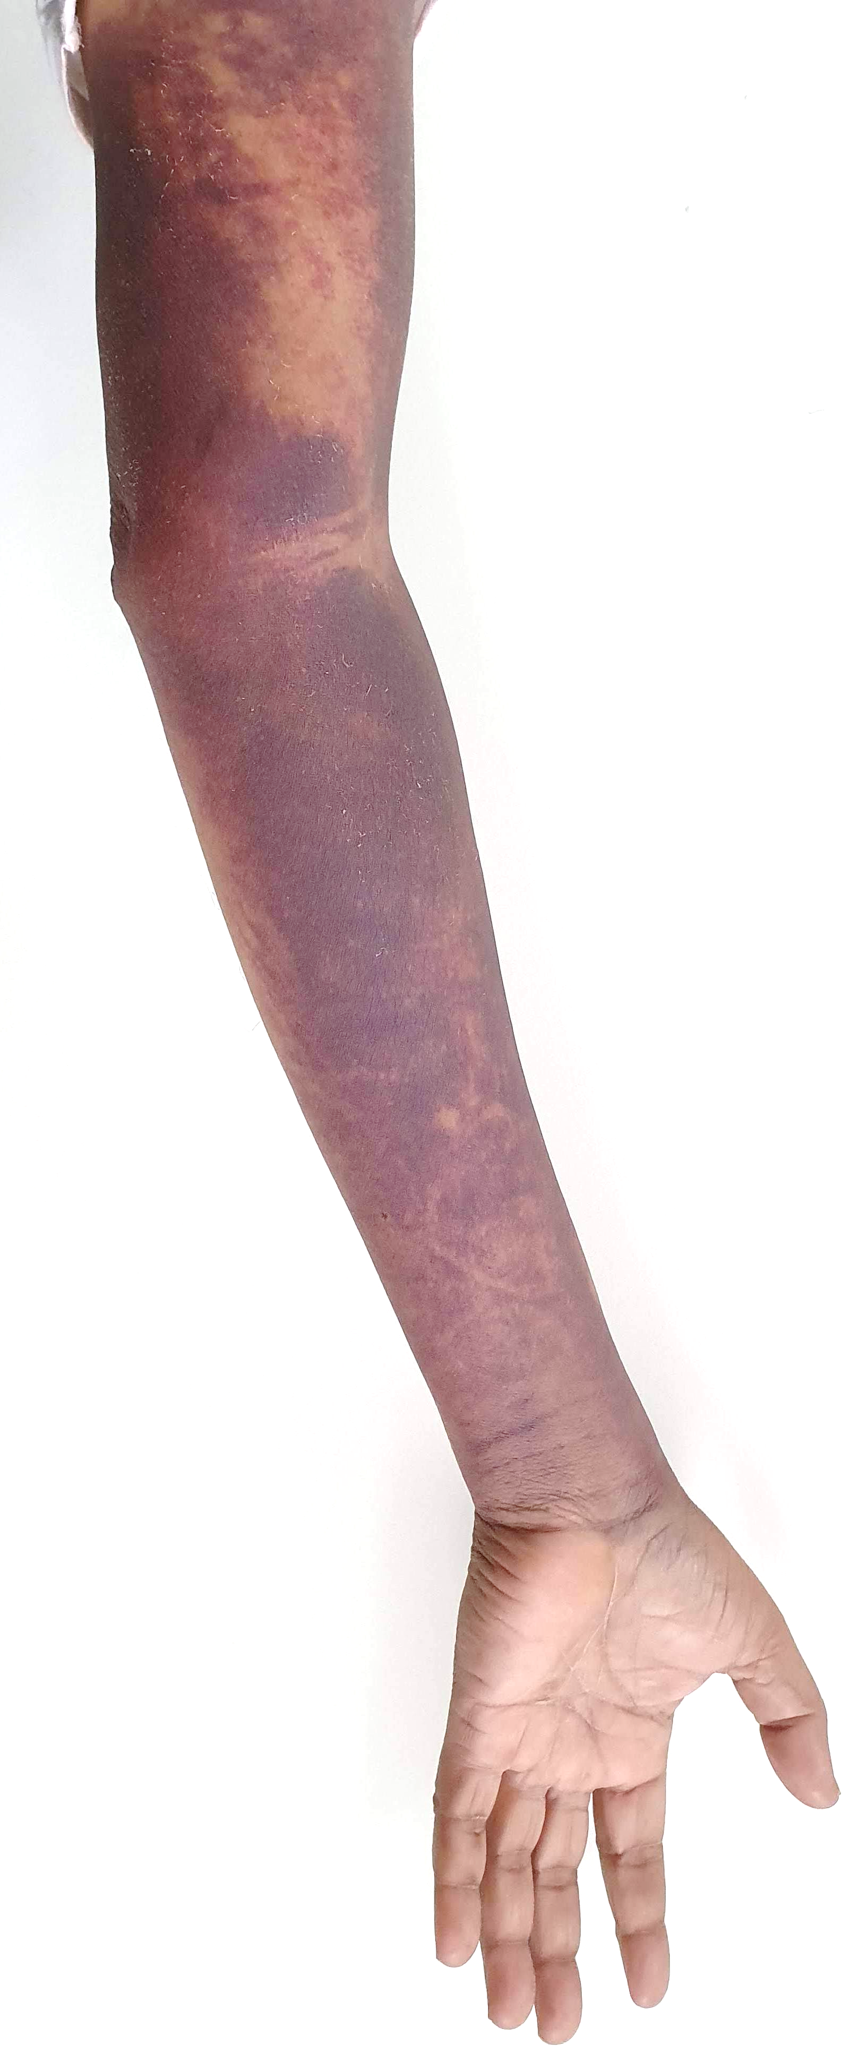
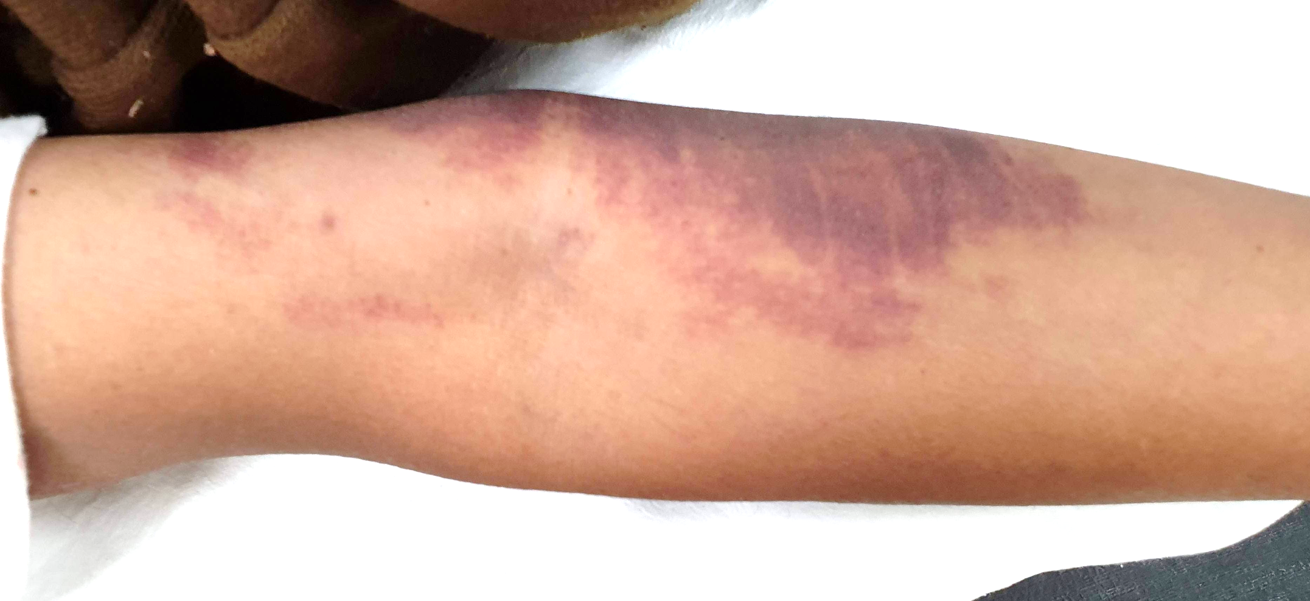
Follow up – 7 Days
Platelet count – 3,95,000/cu mm, INR – 1.1
All other investigations – Normal, 2 D ECHO- Reduced GLS, USG & Doppler – No thrombosis
Fibrinogen Assay Pending

Slide 18
Problems
Why such extensive ecchymoses without any other bleeding tendency?
Another variable manifestation of Covid19?
Cause of Thrombocytosis?
Co-occurence or Association with Convalescent Plasma Therapy?

Slide 19
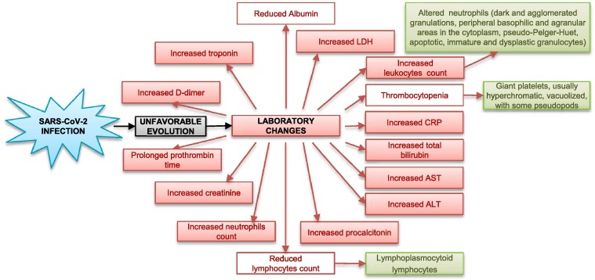
Discussion
Not a single case of Thrombocytosis in COVID 19
Furong Zeng, Xiang Chen, Guangtong Deng Convalescent plasma for patients with COVID-19 PNAS June 9, 2020 117 (23) 12528
Methylene Blue which is used to inactivate the virus, in Convalescent Plasma could reduce several coagulation factors, especially fibrinogen and factor VIII in convalescent plasma which can lead to bleeding manifestations

Slide 20
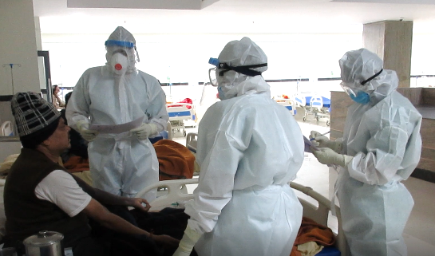
Acknowledgement
Director AIIMS
Maj.Gen. Dr Vibha Dutta SM
Let’s Fight Corona Together
THANK YOU

