Slide 1


Reaching Impact, Saturation, and Epidemic Control (RISE):
Basics of Medical Oxygen Management Systems
Training For Oxygen Program Managers
Date
Notes:
May add the MOH logo if required/requested by host country government

Slide 2
Purpose of the training
At the end of this course, participants are expected to effectively oversee the oxygen ecosystem at their respective levels.
Training objectives
By end of this training, the participants will be able to:
Understand medical oxygen and oxygen therapy, its purpose and devices for oxygen therapy
Correctly communicate on oxygen generation equipment, oxygen storage and delivery devices, and devices for oxygen monitoring
Undertake facility and site requirements for installing oxygen equipment
Ensure safe handling of medical gas
Demonstrate the ability to use oxygen monitoring platforms, like ODAS, OCMIS and ODTS
Understand the rationale for oxygen audit and rational use of oxygen
Show their understanding of the respiratory care market and supplier landscape

Slide 3
Training Schedule
S. No. | Sessions | Methods | Duration
 | Tea and registration of participants
1 | Session I: Introduction and pre-test | Group activity | 30 mins
2 | Session II: Oxygen Therapy | Presentation, and discussion | 60 mins
3 | Session III: Oxygen delivery devices | Presentation, and discussion | 60 mins
4 | Session IV: Oxygen inventory management and oxygen audit | Presentation, and discussion | 90 mins
5 | Session V: Medical gas handling and safety | Presentation, and discussion | 45 mins
6 | Session VI: Respiratory care market and supplier landscape | Presentation, and discussion | 60 mins
7 | Session X: Post- training assessment | Group work and Self-assessment | 45 mins
 | End of training
Reaching Impact, Saturation, and Epidemic Control (RISE)

Slide 4
Session I: Introduction and Pre-test

Slide 5
Session II: Oxygen Therapy
Notes:
May add the MOH logo if required/requested by host country government

Slide 6
Session Overview
01
What is Medical Oxygen?
02
02
What is Oxygen Therapy?
03
03
Indications for Oxygen Therapy
KEY TOPICS THAT WILL BE COVERED IN THIS SESSION
04
04
Oxygen therapy devices
05
05
Oxygen usage and judicious use of oxygen
06
Oxygen usage and rational use of oxygen

Slide 7
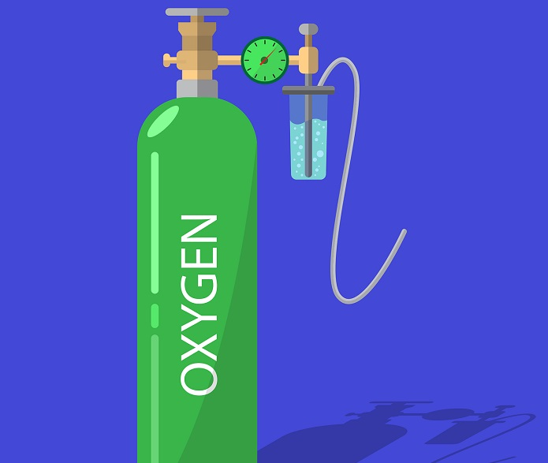
What is Medical Oxygen?
Medical oxygen is high purity oxygen that is used for medical treatments and is developed for use in the human body.
Oxygen is the most important and essential of the drugs for saving the lives of Covid-19 patients.
The COVID-19 pandemic has accelerated global demand for oxygen and made the delivery of oxygen supplies more urgent than ever.
Notes:
Oxygen is an essential medicine used to care for patients at all levels of the healthcare system, including in surgery, trauma, heart failure, asthma, pneumonia and maternal and child care.
In COVID-19 patients demand of oxygen varies, starting about 5th day onwards. Right amount of oxygen at golden hour is life saving.
The need for oxygen has increased to 1.1 million cylinders in low to middle-income countries alone.

Slide 8







Medical Grade Oxygen
Oxygen is not a flammable gas, but it easily supports combustion
An essential medicine required at all levels of the health care system
Materials flammable in air will burn vigorously in oxygen
Oxygen of a minimum 90% purity and free from any contamination
Some fuels, such as oil and grease, burn almost explosively when combined with oxygen
Only high quality, medical-grade oxygen should be given to patients

Slide 9
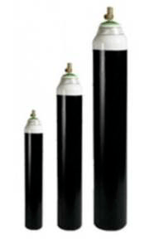
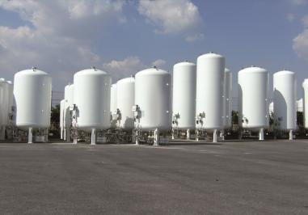
Usually accomplished by a large storage system of liquid oxygen at the hospital which is evaporated into a concentrated oxygen supply, pressures are usually around 345–380 kPa (50.0–55.1 psi)
The gaseous oxygen is stored in the cylinders at 2000 psi with a pressure regulator that allows 50 psi to the patient.
The temperature of liquefaction in the case of oxygen is – 180°C at a pressure of 49.2 atmospheres.
Medical Oxygen
Notes:
Pound per sq inch: PSA

Slide 10
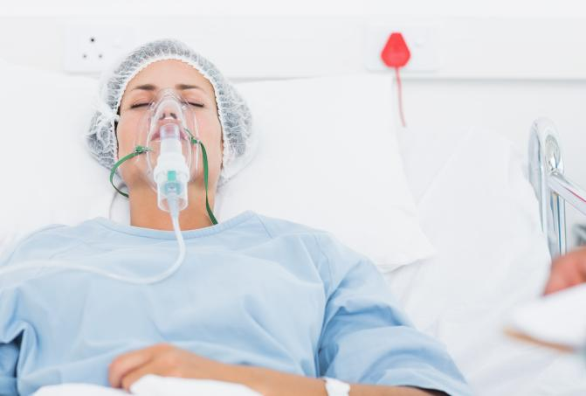
What is Oxygen Therapy?
Goal of Oxygen Therapy:
To maintain adequate tissue oxygenation while minimizing cardiopulmonary work.
Objectives:
Correct documented or suspected hypoxemia
Decrease the symptoms associated with chronic hypoxemia
Decrease the workload hypoxemia imposes on the cardiopulmonary system

Slide 11
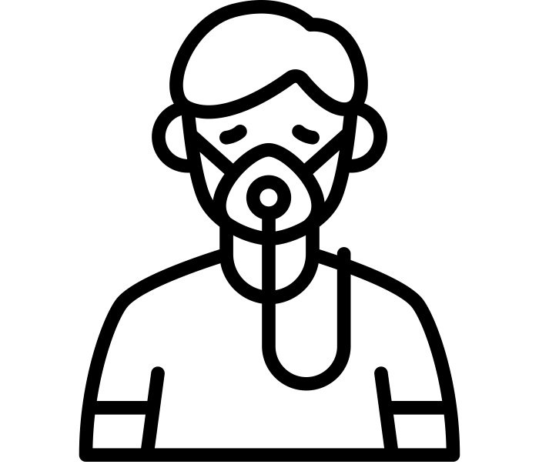


Basic Terminology
Hypoxia: Lack of oxygen availability in tissues
FiO2: Fraction of O2 in Inspired gas
SpO2: Oxygen Saturation

Slide 12


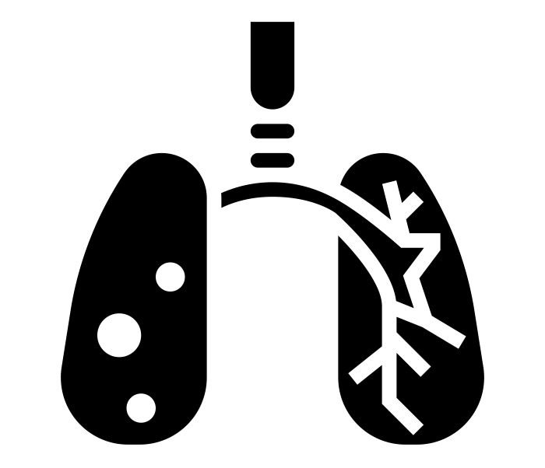
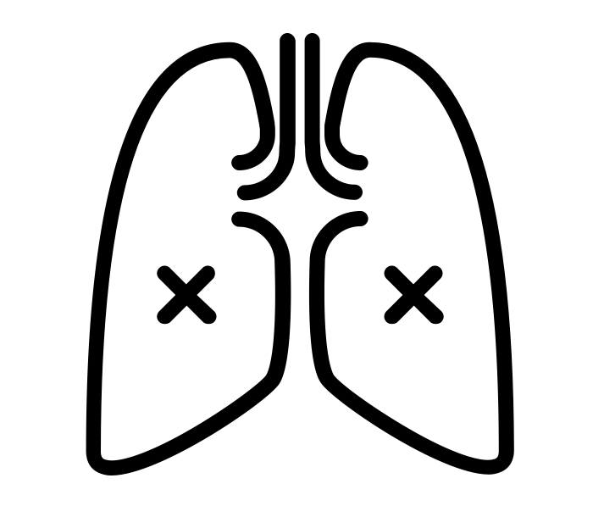




Indications For Oxygen Therapy
Documented hypoxemia as evidenced by
    PaO₂ < 60 mmHg or SaO₂ < 90% on room air
  PaO₂ or SaO₂ below desirable range for a specific clinical situation.
During surgery to maintain tissue oxygenation under anesthesia
Resuscitation of patients
Acute care situations in which hypoxemia is suspected
The treatment of respiratory burns or poisoning by carbon monoxide and other chemical substances
Severe trauma
For the newborn experiencing respiratory distress syndrome
Acute myocardial infarction
The treatment of such diseases as chronic obstructive pulmonary disease, pneumonia, and pulmonary embolism
Notes:
Explain the terminologies.

Slide 13
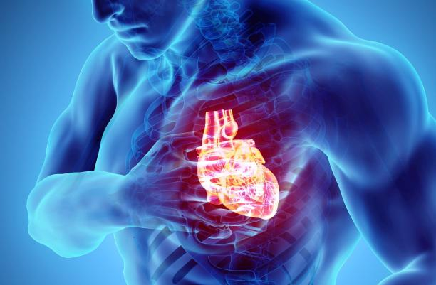
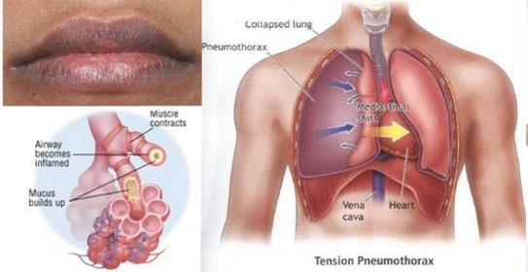
Short Term Oxygen Therapy
ACUTE OXYGEN THERAPY
Acute hypoxemia (PaO2 <60mm Hg; SpO2 <90%)
Cardiac and Respiratory arrest
Hypotension (SBP <100 mm Hg)
Low cardiac output + metabolic acidosis (HCO3‾ < 18 mmol/L)
Respiratory distress (RR > 24/min)

Slide 14
Long Term Oxygen Therapy
Continuous Oxygen
Resting PaO2 <55 mm Hg/ SpO2 <88%
Resting PaO2 of 56-59 mm Hg/ SpO2 of 89% in the presence of cor pulmonale (right heart failure)

Slide 15
Assessment
The need for oxygen therapy should be assessed by
Monitoring of ABG (arterial blood gases)
PaO2 (partial pressure of oxygen), SpO2 (oxygen saturation)
Clinical assessment findings.
PaO2 :
80 – 100 mm Hg : Normal
60 – 80 mm Hg : cold, clammy extremities
< 60 mm Hg : cyanosis
< 40 mm Hg : mental deficiency memory loss
< 30 mm Hg : bradycardia cardiac arrest
PaO2 < 60 mm Hg is a strong indicator for oxygen therapy

Slide 16
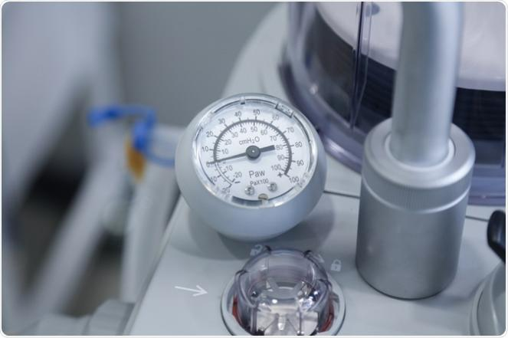
Monitoring
Physical examination for C/F of hypoxemia
Pulse oximetry
ABG (arterial blood gases) analysis
  pH
  pO2
  pCO2
Mixed venous blood oxygenation

Slide 17
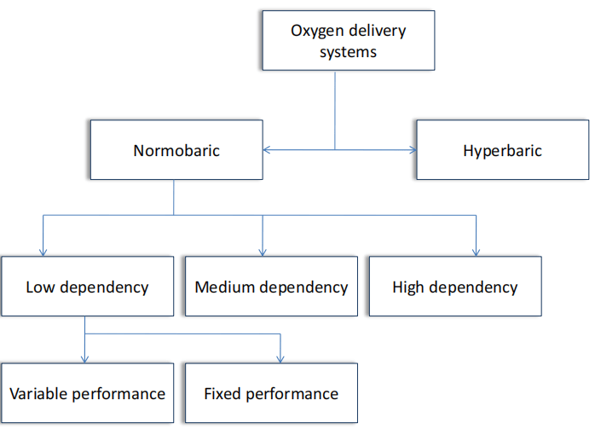
Oxygen Delivery Systems
Oxygen delivery system is a device which is used to administer, regulate and supplement oxygen to a subject to increase the arterial oxygenation.
Choice of delivery system is based upon:
Degree of hypoxemia
Requirement for precision of delivery
Patient comfort
Cost

Slide 18
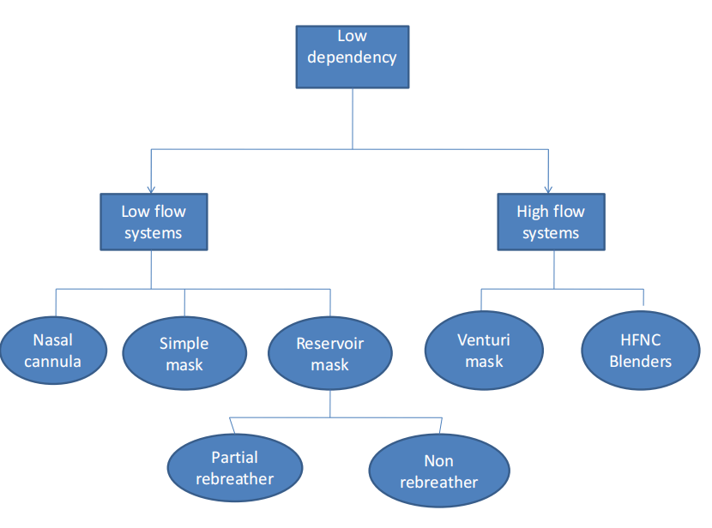
Low Dependency Devices

Slide 19
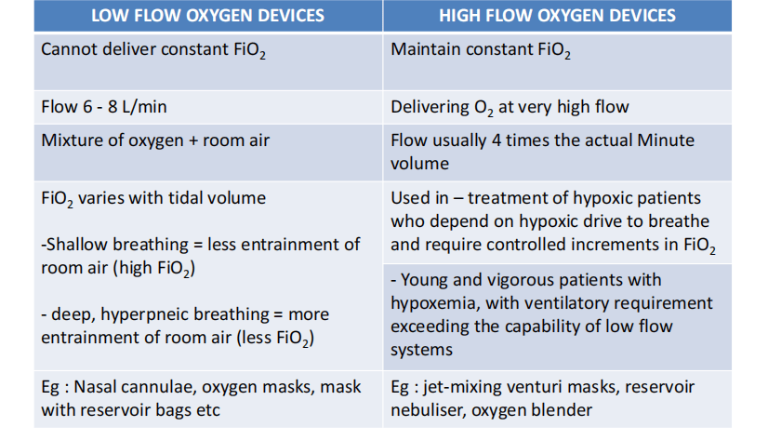
Low Dependency Devices
FiO2: Fraction of inspired oxygen

Slide 20
Low Flow Devices
  Low flow (Variable performance devices )
    Nasal cannula (prongs or spectacles)
    Nasal catheters
    Transtracheal catheter
    Face mask
  Reservoir system (Variable performance device)
    Reservoir cannula
    Simple face mask
    Partial rebreathing mask
    Non rebreathing mask
    Tracheostomy mask
  High flow (Fixed performance devices)
    Venturi mask (HAFOE)
    Aerosol mask and T-piece with nebulizers
    Partial rebreathing mask
    Non-rebreathing mask
    Tracheostomy mask

Slide 21
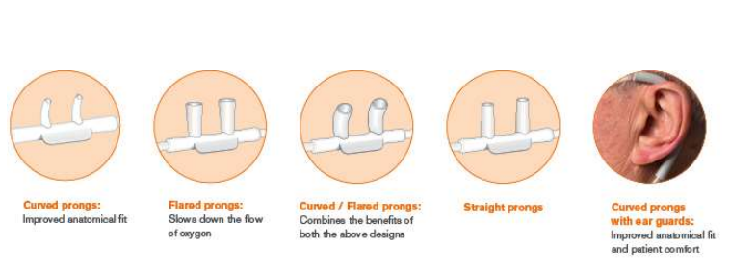
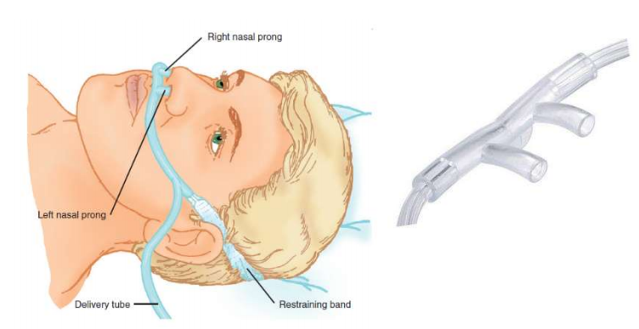
Nasal Cannula
Consists of two soft prongs attached to oxygen supply
A flow rate of 2-4L/min delivers an FiO2 of 0.28-0.36 respectively
FiO2 = 20% + (4 x oxygen litre flow)
No increase in FiO2 if flow is more than 6L/min
Nasopharynx acts as a reservoir
If patient breaths through mouth, air flow produces a Venturi effect in the posterior pharynx entraining oxygen from the nose
Available in different sizes and different prong shapes

Slide 22
Nasal Cannula
Advantages:
Ideal for patients on long-term oxygen therapy
Light weight and comfortable
The patient is able to speak, eat and drink
Humidification not required
Low cost (Rs. 70/-)
Disadvantages
Can not provide high flow oxygen
Irritation and cannot be used in nasal obstruction
FiO2 varies with respiratory efforts
High flow rates are uncomfortable

Slide 23
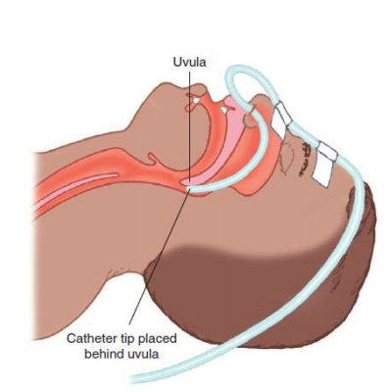
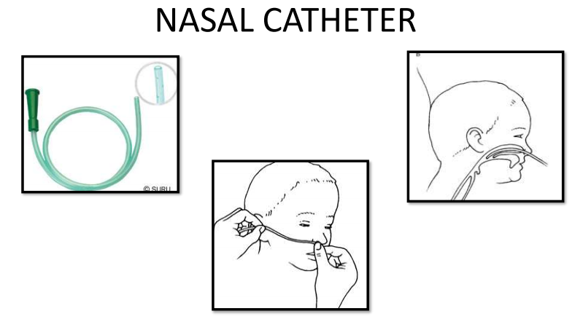
Nasal Catheter
Single lumen catheter, which is lodged into the anterior naris by a foam collar, inserted to just above the uvula
Oxygen flows of 2-3 L/min can be used. FiO2 = 35-40%
Deep insertion can cause air swallowing and gastric distension
Must be repositioned every 8 hours to prevent breakdown
No advantages over nasal cannula
Notes:
It should not be used when a nasal mucosal tear is suspected because of the risk of surgical emphysema

Slide 24
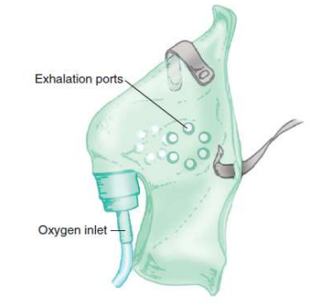
Simple Face Mask
Transparent mask provided with side holes
Reservoir capacity 100-250ml
Different oxygen flow rates result in a highly variable and unpredictable FiO2
Rebreathing of CO2 can occur with oxygen flow rates of less than 2L oxygen/min or if minute ventilation is very high
4 L/min of oxygen flow delivers an FiO2 of about 0.35-0.4 provided there is a normal respiratory pattern
Flow rates greater than 8L/min do not increase FiO2

Slide 25
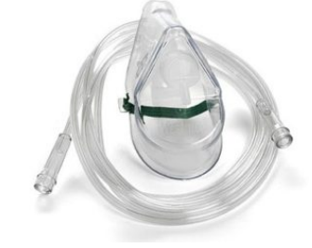
Simple Face Mask
Advantages:
Less expensive (RS 80/-)
Can be used in mouth breathers
Disadvantages:
Uncomfortable
Require tight seal
Do not deliver highFiO2
FiO2 varies with breathing efforts
Interfere with eating, drinking, communication
Difficult to keep in position for long
Chances of rebreathing are high

Slide 26
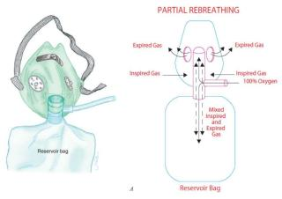
Partial Rebreathing Mask
Mask with reservoir bag of capacity 1 litre
Oxygen flows directly into the reservoir bag, which fills during exhaustion
Deliver an FiO2 between 0.6 and 0.8
A minimum of 8L/min should enter the mask to remove exhaled CO2 and refill oxygen reservoir
Flow rate must be sufficient to keep bag 1/3 to ½ inflated at all times
Advantages:
Inspired gas not mixed with room air
Patient can breathe room air through exhalation ports if oxygen supply gets interrupted
Disadvantages:
More oxygen flow does not increase FiO2
Interfere with eating and drinking
Notes:
Designed in such a way that it captures exhaled gases from initial part of expiration from the dead spaces
Useful in situations where supplies are limited

Slide 27
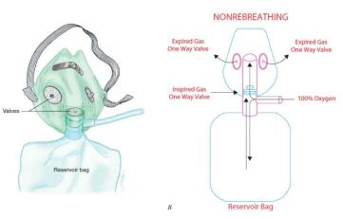
Non-Rebreathing Mask
Provided with one way valves between mask and bag, exhalation ports
FiO2 of 95% can be achieved with an oxygen flow rates of 10 to 15 L/min
Higher oxygen supply rates are required
Desirable in cases where rebreathing of CO2 would be detrimental, for example after head injury
Notes:
Ideally NRBM should not allow entrainment of air, but because of safety concerns one of the two exhalation ports is not provided with valve
Best results will be achieved by adequate flow rates such that the reservoir bag empties by no more than a third inspiration and by best seal possible between the mask and the face.

Slide 28
Non-Rebreathing Mask
Advantages:
Highest possible FiO2 without intubation
Suitable for spontaneously breathing patients with severe hypoxia
Disadvantages:
Expensive
Require tight seal, Uncomfortable
Interfere with eating and drinking
Not suitable for long term use
Malfunction can cause CO2 build-up, suffocation

Slide 29
High Flow Devices
Air Entrainment Mask (Venturi)
High Flow Nasal Oxygen Therapy/ High Flow Nasal Cannula
NIV (Non-invasive ventilation) Masks
HAFOE (High air flow with oxygen enrichment mask) systems
Anesthesia circuits
Ventilators
Non-invasive
Invasive

Slide 30
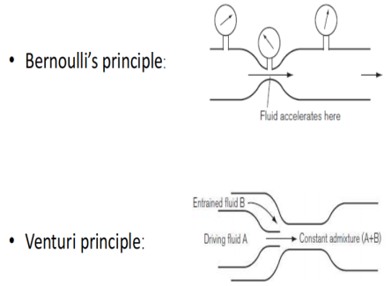
Venturi Mask
Based on Venturi modification of Bernoulli principle
Gas flow is sufficient to meet the demands of patient
The plastic body of the mask with holes on both sides
The proximal end of the mask consists of a venturi device. The Venturi devices are color-coded and marked with the recommended oxygen flow rate to provide the desired oxygen concentration.
Alternatively, a calibrated adjustable venturi device can be used to deliver the desired FiO2
Notes:
“Bernoulli's principle is an idea of fluid dynamics. It says that as speed of the fluid increases, pressure decreases. A higher pressure pushes (accelerates) fluid toward lower pressure. So any change in a fluid's speed must be matched by a change in pressure (force)”
Not synonymous with high concentration of oxygen

Slide 31
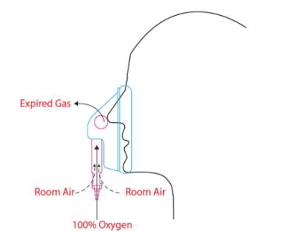
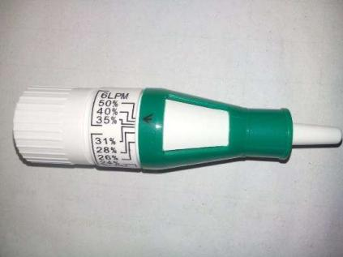
Jet Venturi Mask Or
Entrainment Mask (AEM)

Slide 32
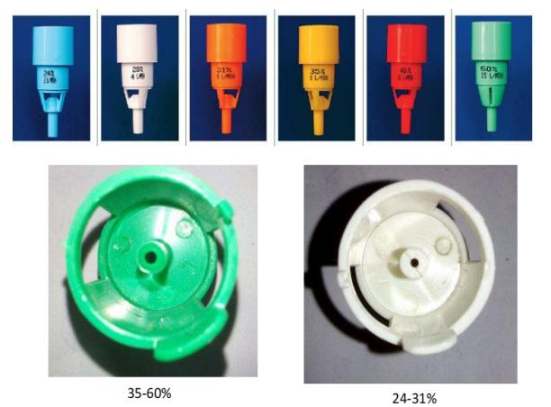
Venturi Mask
Delivers fixed concentration of oxygen
The size of the constriction determines the final concentration of oxygen for a given gas flow
As forward flow of inspired gas increases, the lateral pressure adjacent and perpendicular to the vector of flow decreases, resulting in entrainment of gas.
The smaller the orifice is, the greater the negative pressure generated, so the more ambient air entrained, the lower the FiO2
FiO2 can be 0.24, 0.28, 0.31, 0.35, 0.4, 0.6
Because of the high fresh gas flow rate, the exhaled gases are rapidly flushed from the mask, via its holes.
These masks are recommended when a fixed oxygen concentration is desired in patients whose ventilation is dependent on the hypoxic drive.
Notes:
Therefore, there is no rebreathing and no increase in dead space.

Slide 33
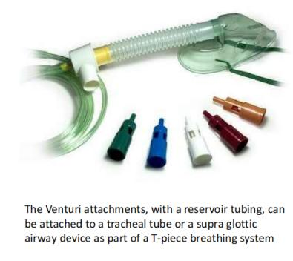
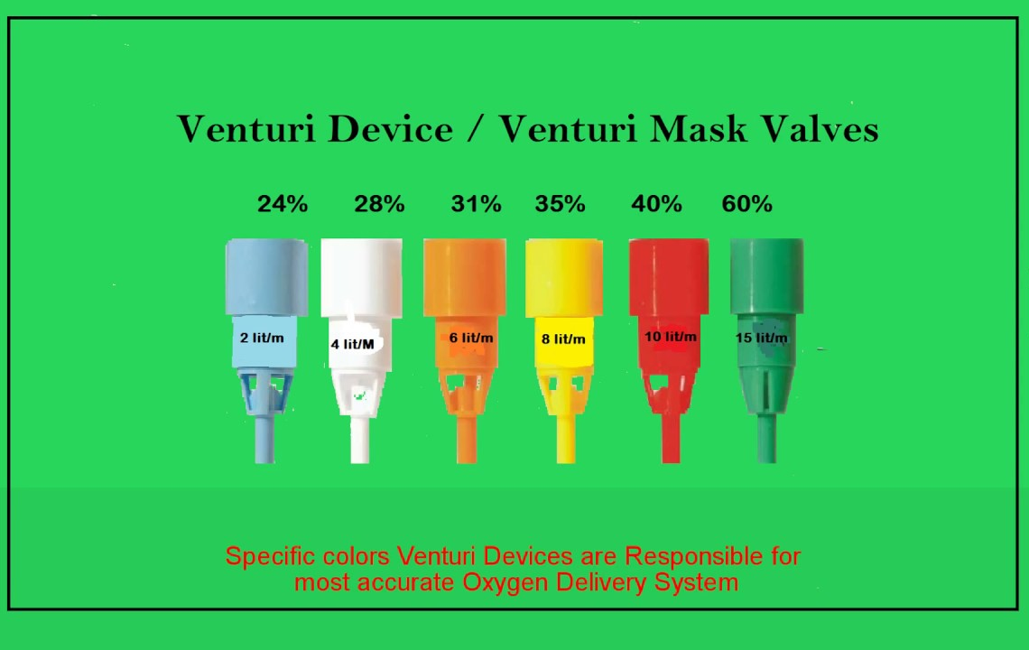
Venturi Mask Combinations
Image reference: https://www.youtube.com/watch?v=W2mbRyTt_7k

Slide 34
Venturi Mask
Advantages:
Fine control of FiO2 at fixed flow
Fixed, reliable, and precise FiO2
High flow comes from the air, saving the oxygen cost
Can be used for low FiO2 also
Helps in deciding whether the oxygen requirement is increasing or decreasing
Disadvantages:
Uncomfortable
Expensive (400-600)
Cannot deliver high FiO2
Interfere with eating and drinking

Slide 35
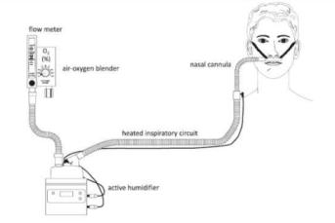
High Flow Nasal Cannula
Delivers heated and humidified oxygen via special devices (eg, Vapotherm)
Rates up to 8 L/min in infants and up to 40 L/min in children and adults
FiO2 remains relatively constant
Because gas is generally warmed to 37°C and completely humidified, mucociliary functions remain good and little discomfort is reported
Notes:
In patients with respiratory distress or failure, oxygen by humidified high-flow nasal cannula may be better tolerated than by face mask

Slide 36
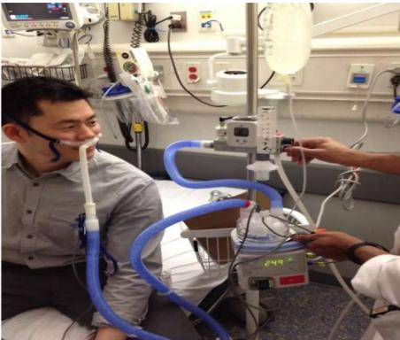
High Flow Nasal Cannula
When high oxygen concentration/ flow is required
Inlet – separate pressurised air, oxygen source
Gases are mixed inside either manually or with blender
Output – mixture of air and oxygen with precise FiO2 and flow
Ideal for spontaneously breathing patients requiring high FiO2

Slide 37
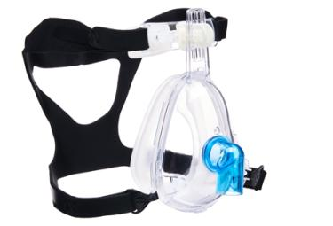
NIV Mask (Non-Invasive Ventilation)
Flow : 20 – 40 L/min
Fio2 : Up to 100%
Side-effects:
  Claustrophobia
  Pressure sore
Also known as: BIPAP or Ventilator

Slide 38
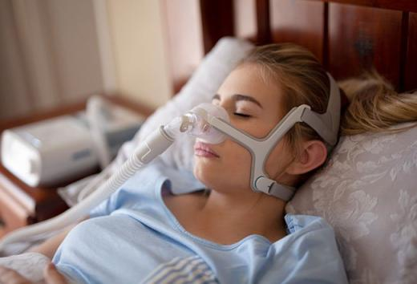
Non-Invasive Ventilation
Avoids intubation
Reduces work of breathing
BIPAP machine/Ventilator
Contraindications
  Hemodynamic instability
  Multi organ failure
  Altered mental status

Slide 39
Judicious Use Of Oxygen
The flow of oxygen should be adjusted to the lowest permissible level to target an oxygen saturation of 92%- 94% for the hospitalized Covid-19 patients.
Oxygen concentrator if available should be used for patients initially and in recovering stage.
Oxygen delivering masks should be tightly fitted to achieve maximum FiO2 and prevent leakage.
Oxygen delivering devices should be used in chronological order with their specific flow rate.
OXYGEN DELIVERING DEVICE | FLOW RATE
Nasal Prongs | 2-6 Litre per minute
Simple Face Mask | 5-8 Litre per minute
NRBM (High Flow Mask) | 10-12 Litre per minute (maximum up to 15 Litre per minute) flow should be adjusted to keep the reservoir bag inflated.

Slide 40
Judicious Use Of Oxygen
Individualization of oxygen therapy should be done taking into account the clinical signs like respiratory rate etc.
If patient is not maintaining saturation the device should be upgraded instead of increasing the flow rate beyond the prescribed range .
Triaging of patients as per their oxygen status should be done at regular intervals.
Reverse should be followed during weaning.
One staff should be dedicated in each shift for continuously checking any leakage from oxygen source or delivery device.
Indiscriminate use of BIPAP/HFNC should be avoided. When required, BIPAP should be preferred over HFNC; the latter consumes enormous amount of oxygen.
Close the oxygen valves when not in use like patient is taking meals or is not on bed.
Prone positioning should be intermittently done in patients of COVID -19 along with adjunctive physiotherapy. This optimizes the respiratory status.
Divide the hospital in two zones ,one for patients having high oxygen demand and other for those needing less or no Oxygen.
Notes:
HFNC device should be used only in the lCU setting under supervision of a respiratory physician. Patient should be put on HFNC only after approval of the senior most respiratory physician.

Slide 41
Conclusion
Oxygen is a drug.
In COVID-19 patients demand of oxygen varies, starting about 5th day onwards. Right amount of oxygen at golden hour is life saving.
It is extremely important to be well aware of the required purity and flow of oxygen and follow the set standards.
For sustainable use of oxygen, one must avoid over-exploitation of resources and oxygen wastage.
“When appropriately used, it is extremely beneficial,
When misused or abused, it is potentially harmful.”
Notes:
One may prone for up to 16 hours a day, in multiple cycles, as felt comfortable.

Slide 42
Thank You!
This presentation was made possible with support from the United States Agency for International Development funded RISE program, under the terms of the cooperative agreement 7200AA19CA00003. The contents are the responsibility of the RISE program and do not necessarily reflect the views of USAID or the United States Government.​

Slide 43
Session III: Oxygen Delivery Solutions
Notes:
May add the MOH logo if required/requested by host country government

Slide 44





Session Overview
Oxygen production source
Oxygen storage source
KEY TOPICS THAT WILL BE COVERED IN THIS SESSION
Oxygen delivery to patients
Patient monitoring devices
Oxygen supply chain

Slide 45
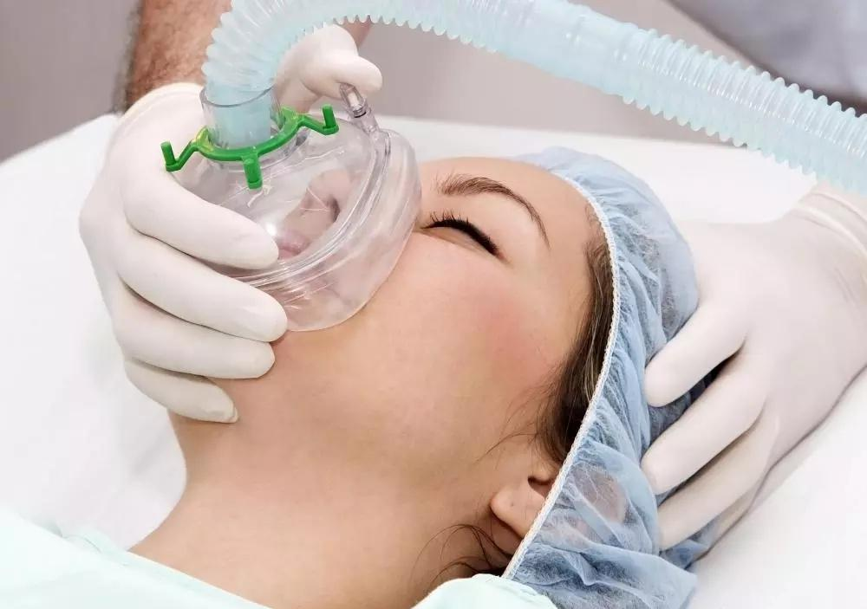
Oxygen Ecosystem
Oxygen Source
Concentrator
Distribution
Central or sub-central piping
Delivery
Nasal cannula
Regulation & Conditioning
Regulator
Patient Monitoring
Cylinder
PSA/VSA/VPSA Plant
Liquid Medical Oxygen (ASU Plant)
Tubing
Transport (for cylinders)
Transport (for Liquid Oxygen)
Flowmeter
Flowmeter stand (flow splitter)
Humidifier (heated and non-heated)
Blender
CPAP
BiPAP
Ventilator
Nasal catheter
Masks
Tubing
Non ReBreather Mask
Pulse oximeter
Multi-parameter monitor

Slide 46
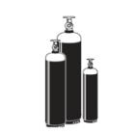
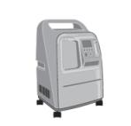
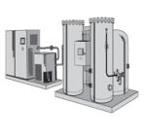
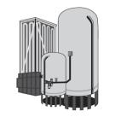
Different Sources of Medical Oxygen
Cylinders | Concentrators | Oxygen plant (PSA) | Liquid oxygen
Clinical application and/or use case | Can be used for all oxygen needs, including- high-pressure supply; facilities where power supply is intermittent or unreliable; ambulatory service or patient transport; backup for other systems. | Used to deliver oxygen at the bedside or within close proximity to patient areas. A single concentrator can service several beds | Can be used for all oxygen needs, including high-pressure supply. | Can be used for all oxygen needs, including- high-pressure supply and in facilities where power supply is intermittent or unreliable.
Appropriate level of health system | Primary, secondary, possibly tertiary (any medical unit requiring oxygen). | Primary, secondary, possibly tertiary (any medical unit requiring oxygen). | Secondary and tertiary. | Secondary and tertiary.
Notes:
A single concentrator can service several beds with the use of a flowmeter stand to split output flow.

Slide 47
Oxygen Production Sources

Slide 48
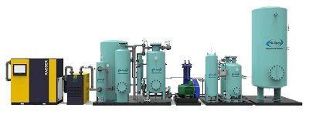
Pressure Swing Adsorption (PSA) Plant
Pressure swing adsorption (PSA) is the process by which ambient air passes through an internal filtration system (e.g., a molecular sieve of zeolite granules or membranes), which has a large enough total surface area to separate nitrogen from the air, concentrating the remaining oxygen to a known purity.
It typically consists of an air compressor, dryer, filters, dual separation chambers, a reservoir, and controls.
PSA Plant

Slide 49
PSA Generator Plant – Pros & Cons
Pros
PSA could be primary source for small as well as larger hospitals
Cons
Good access up to hospital facility is required during installation and maintenance purposes.
Relatively compact, needs enclosed space for installation
Efficient, oxygen is produced as per requirement
Reduces dependence on manpower
Safe to operate and maintain
Maintenance is preventive
Eliminates third party dependence
Assured power supply is a mandatory requirement. PSA plant needs Diesel Generator backup in case of power failures.

Slide 50
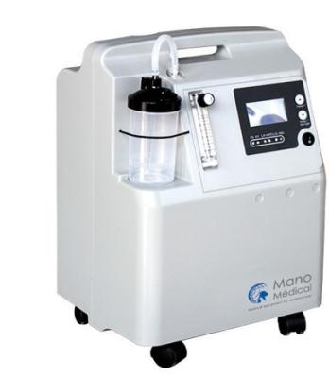
Oxygen Concentrator
Oxygen Concentrator is a self-contained, electrically powered medical device designed to concentrate oxygen from ambient air, using PSA technology*.
Used to deliver oxygen at the bedside or within close proximity to patient areas.
A single concentrator can service several beds with the use of a flowmeter stand to split output flow.
* Pressure swing adsorption (PSA) is a technology used to separate some gas species from a mixture of gases under pressure according to the species' molecular characteristics and affinity for an adsorbent material.

Slide 51

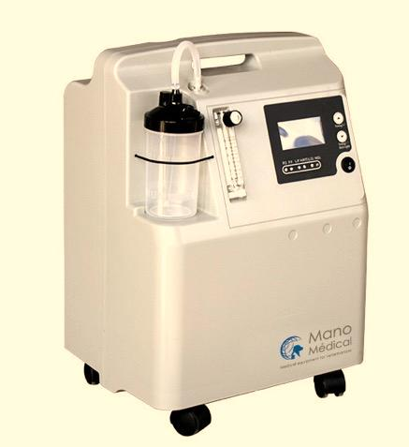








Can be Portable or Stationary
Provide a safe and cost-efficient source of oxygen
Require a source of continuous and reliable power
Need regular preventive maintenance
Do not need to be refilled
Can supply an unlimited amount of oxygen

Slide 52
Oxygen Concentrators- Pros & Cons
Pros
They do not need to be refilled.
Cons
Need for electrical power to function. Necessary to prepare for unscheduled power outages by setting up a backup power generator
They concentrators run on electrical power and thus supply an unlimited amount of oxygen.
Portable concentrators can be used in an “on-the-go” mode with a battery pack
More cost-effective than compressed gas cylinders, and they are known to last for up to 1500 h of continuous use.
Patients using stationary oxygen concentrators need to change filters weekly and regular servicing
Noise and vibration from older devices

Slide 53
Oxygen Storage Sources

Slide 54

Liquid Oxygen Containers
Liquid oxygen is stored, shipped, and handled in several types of containers, depending upon the quantity required
The types of containers in use include the dewar, cryogenic liquid cylinder, and cryogenic storage tank
Storage quantities vary from a few liters to many thousands of gallons (In India IS 7396:2017 is followed)
Since heat leak is always present, vaporization takes place continuously
Rates of vaporization vary, depending on the design of the container, external temperatures and the volume of stored product
Containers are designed and manufactured according to the applicable codes and specifications for the temperatures and pressures involved.
Liquid oxygen is a cryogenic liquid, pale blue in colour with a has a boiling point of –297°F (–183°C).
It is a compressed form of oxygen, required to be stored much below -200°C, to ensure that the oxygen remains in the liquid form.

Slide 55
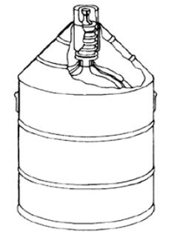
Dewars
It is is non-pressurized
A loose-fitting dust cap over the outlet of the neck tubes prevents atmospheric moisture from plugging the neck and allows gas produced from vaporized liquid to escape
Unit of measure for the capacity of a dewar is the litre
Five- to 200-litre dewars are available
Product may be removed from small dewars by pouring, while larger sizes will require a transfer tube
A Dewar Container

Slide 56
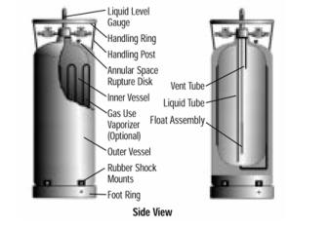
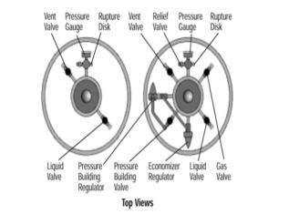
Cryogenic Liquid Cylinders
(Dura Cylinder)
Cryogenic liquid cylinders are insulated, vacuum-jacketed pressure vessel
They are equipped with pressure relief valves and rupture disks to protect the cylinders from pressure buildup.
Liquid containers operate at pressures in the range of 100 psig to 350 psig (24 atm) and have capacities between 80 and 450 liters of liquid
Oxygen may be withdrawn as a gas by passing liquid through an internal vaporizer or as a liquid under its own vapor pressure

Slide 57
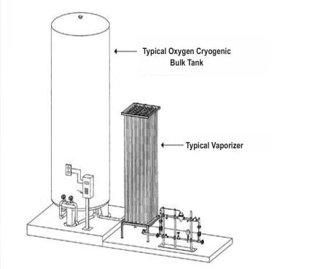
Cryogenic Storage Tanks
Customer installations generally include a tank, vaporizer, and pressure control manifold.
Tanks are generally cylindrical in shape and are mounted in fixed locations as stationary vessels or on railcar or truck chassis for easy transportation.
All tanks are powder- and vacuum-insulated in the annular space and equipped with various circuits to control product fill, pressure buildup, pressure-relief, product withdrawal, and tank vacuum.
Tanks are designed to national and international specifications for the pressures and

Slide 58
LMO - Pros & Cons
Pros
Liquid oxygen can be stored in a portable tank and connected to a Central pipeline.
Liquid oxygen is highly concentrated, so more oxygen can be stored in a smaller tank and ensure continuous supply at high pressure.
Most cost-effective system for larger facilities.
Cons
Liquid oxygen cannot be stored for more than a week or two because it will vaporize (evaporate) and build-up pressure inside storage tank.
The tank's content must be consumed and refilled often, requiring the scheduling of deliveries.
The system need PESO license compliance.

Slide 59
Oxygen Cylinders
Oxygen gas can be compressed and stored in cylinders.
These cylinders are filled at a gas manufacturing plant,
  a cryogenic distillation/ASUs in liquid oxygen form or a processss known as pressure swing adsorption (PSA) in gaseous oxygen form
  or by an LMO-based re-filler and transported to health facilities to be connected to manifold systems (groups of cylinders linked in parallel)
These are piped to areas of the health facility; or cylinders can be used directly within patient areas.
Cylinders do not require electricity, but they do require several accessories and fittings to deliver oxygen, such as pressure gauges, regulators, flowmeters, and, in some cases, humidifiers.
Cylinders also require periodic maintenance, commonly provided by gas suppliers at the point of refilling.

Slide 60
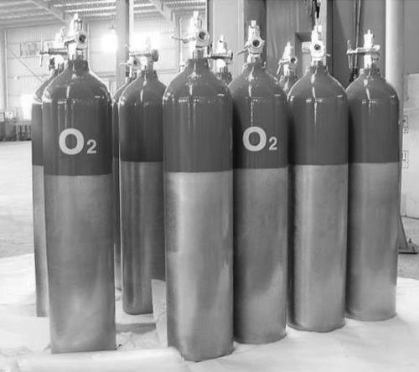
Oxygen Cylinder – Pros and Cons
Pros
Installation does not need permission from any authority like Petroleum and Explosives Safety Organization (PESO).
Cons
Recommended as primary source for small size hospital up to 30 beds.
Space accommodating as construction is long and linear.
Easy setup, can also be used bedside without medical gas pipe system.
Not recommended (specially in current pandemic) as primary source to ICU's.
Erratic supply chain.
Chances of carrying infection.

Slide 61
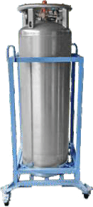
Oxygen Cylinders Types
Cylinders type
(Gaseous Medical Oxygen)
Dura Cylinder
(Liquid Medical Oxygen

Slide 62
Oxygen Cylinder Type B & D
B
D
B-Type Small Medical Oxygen Cylinder (1.5 CU.M.)
B-type high pressure seamless cylinder for medical oxygen gas, cylinder is ISI marked conforming to IS:7285 part 2, certified by the Bureau of Indian Standards (BIS) and approved by the chief controller of explosive (CCOE) Government of India.
Cylinder made from manganese steel.
10.2 ltr. Water capacity (40 cu.ft.).
Valve made of brass and chrome plated.
Working pressure 150 kg. F/cm at 15 deg. C.
Hydraulic test pressure 250 kg. F/cm .
Colour code of the cylinder should be as per IS: 3933-1966 with updating till date.
Filled with medical oxygen gas of medical grade.
Matching key cum spanner to release oxygen for each cylinder separately.
Minimum two years guarantee for cylinder.
D-Type Jumbo Medical Oxygen cylinder (7 CU.F.M.)
Cylinder made from manganese steel.
46.7 Ltr. water capacity (220 CU.FT.).
Valve made of brass and chrome plated.
Working pressure 150 Kg. f/cm at 15 deg. C.
Hydraulic test pressure 250 Kg. f/cm .
Filled with medical oxygen gas of medical grade.
Matching key cum spanner to release oxygen for each cylinder separately.
Minimum two years guarantee for cylinder.

Slide 63
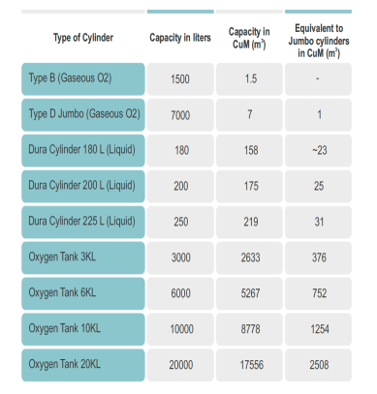
Cylinder Naming & Sizing
Oxygen cylinders are of different sizes.
Cylinder sizes for medical gases are named alphabetically, unlike industrial cylinders which are numbered.
In India most commonly used cylinders are D type (Jumbo) and B type (Portable) cylinders which contains gaseous oxygen. Dura cylinders with liquid oxygen are also used in the region.
Cylinders are fitted with customized valves (either pin index or bullnose type) that are opened with valve keys, and with valve guards for safety.
The Pin Index Safety System (PISS) is designed to ensure the correct gas is connected to the regulator or other equipment.
The arrangement of the pins is unique for each gas, and the positions of the holes on the cylinder valve must correspond with the pins to prevent the use of the wrong gas.
Some cylinders have built-in, integral pressure regulators, which do not require a separate pressure regulator to be fitted to the cylinder valve before use.

Slide 64
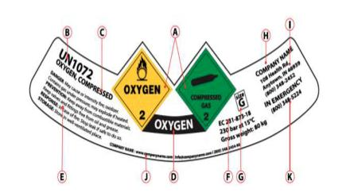
Diamond hazard label: displaying the primary hazard with additional hazard labels displaying any subsidiary hazards. These labels will display the dangerous goods classification number.
UN number: preceded by the letters UN. The UN number is a number assigned by the United Nations Committee of Experts on the Transport of Dangerous Goods. The UN number for compressed oxygen is UN 1072.
Proper shipping name.
Product name (may be omitted if the proper shipping name is identical).
Signal word, hazard and precautionary statements.
EC number (if applicable).
Package size and pressure.
Company name.
Address of the gas company.
Additional company information.
Contact telephone number.

Slide 65
Oxygen Delivery to Patients

Slide 66

Medical Gas Pipeline System (MGPS)
MGPS is installed to provide a safe, convenient, and cost-effective system for the provision of medical gases to the clinical and nursing staff at the point-of-use.
It reduces the problems associated with the use of gas cylinders such as safety, porterage, storage, and noise.
Patient safety is paramount in the design, installation, commissioning, and operation of medical gas pipeline systems.
The basic principles of safety are achieved by ensuring quantity of supply, identity of supply, continuity of supply and quality of supply.
Pipeline systems supply oxygen at a high pressure to equipment such as anaesthetic machines and ventilators.
Pro
They obviate the need for handling and transporting heavy cylinders between hospital wards
Cons
The high cost of installing centralized oxygen sources with copper pipelines and the high level of specialized maintenance may make these systems of unsuitable for many hospitals.

Slide 67
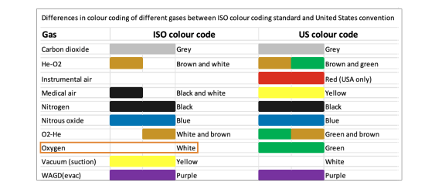
Colour Coding for Medical Gas Pipelines
According to the ISO standard, oxygen should be labelled as white.
The figure shows differences in gas cylinder colour coding between ISO and US standards.

Slide 68
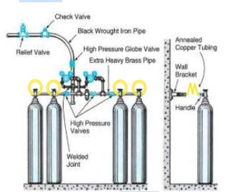
Working of Manifold
Jumbo manifold system has two banks and one reserve bank.
Each bank connected to a common header with a separate manifold pressure regulator & and banks alternately supply the pipeline.
Manifold system operates on differential pressure mechanism.
The secondary bank comes into operation automatically when content of the primary bank is exhausted.
Manifold control panel assists in switching automatically between left bank and right bank.
Automatic control panel need no power or electricity requirement for operation.
In case of power failure, control panel has fail-safe mechanism, if required.
Both right and left bank opens in case of power failure and will ensure unobstructed flow to hospital on self-displacement method.

Slide 69


Oxygen Concentrators- Patient Delivery Consumables & Accessories
Options for dividing flow to multiple patients-
Some concentrators have two built-in flowmeters, with two corresponding oxygen outlets, to treat two patients simultaneously.
This avoids the need for additional user assembly but is limited to a maximum of two patients that can be treated at the same time.
Only some concentrators designated as paediatric have built-in flowmeters capable of titrating oxygen to very low flows (0.1–0.2 LPM).
Flowmeter stands consisting of from two to five mounted meters can be used.
This has advantage of being more familiar to clinical staff who are used to using flowmeters on cylinders and allows precise titration of flow to each individual patient (including down to 0.1 LPM).

Slide 70
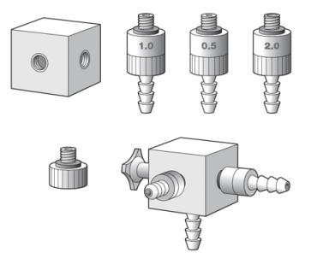
Oxygen Concentrators- Patient Delivery Consumables & Accessories
A four-way flow splitter assembly has been used as a method to split flow.
It consists of a four-way flow splitter block, nozzles for 0.5, 1 and 2 LPM and blanking plugs.
Flow splitters are less preferred than flowmeter stands or built-in paediatric flowmeters, since the corresponding blanking plugs are very easily lost or misplaced.
Flow splitters use nozzles that deliver oxygen at a single fixed rate.
Flow Splitter, Nozzles and Blanking Plugs

Slide 71
Simple Oxygen Patient Delivery Interface Equipments
Oxygen mask – covers lower part of face
Non-rebreather mask (NRBM) – can deliver higher concentrations of oxygen than cannula and regular mask
Exhaled air exits through 1 way valves thus preventing any rebreathing of exhaled air or room air
Oxygen cannula – prongs that are placed in the nose for providing oxygen to patient

Slide 72
Higher Flow/Complex Oxygen Patient Delivery Equipments
Invasive mechanical ventilation
Through intubation, oxygen is pumped into a patient’s lungs
High flow nasal cannula
Specialized cannula designed to provide oxygen up to 60LPM and limit inhalation of room air

Slide 73
Humidifiers
There are various types of humidifiers, and their designs differ in how they apply three main principles :
1. Temperature: As the temperature of gas increases, its ability to hold water vapour increases.
2. Surface area: There is more opportunity for evaporation to occur due to greater surface area of contact between water and gas.
3. Time of contact: There is more opportunity for evaporation to occur when a gas remains in contact with water for long duration.
  Oxygen humidifiers are medical devices that can be integrated into oxygen delivery systems to humidify supplemental oxygen.
  Humidification is not necessary when oxygen is delivered at relatively low flow rates through nasal prongs or nasal catheters
  When oxygen is delivered at higher-than-standard flow rates, or when methods of oxygen delivery bypass the nose, such as when nasopharyngeal catheters are used, humidification is needed – especially when cold oxygen is delivered from a cylinder.

Slide 74



Types of Humidifiers
 | Bubble humidifier – Non heated (reusable) | Bubble humidifier – Non heated (single use) | Bubble humidifier – heated
Description | A reusable bottle that reduces the dryness of oxygen by bubbling the gas through distilled water (or water that has been boiled and cooled) at room temperature. | A single-use bottle that reduces the dryness of oxygen by bubbling the gas through distilled water at room temperature. | A device consisting of a heat source and a humidification chamber whereby the built-in heater warms the water in the chamber to add moisture to the airstream as it passes over the surface.
Merits | Simple. No power required. Low cost. Reusable. | Simple. No power required. Low cost. Reusable. | Adjustable heat for more or less moisture. More efficient at humidifying gas.
Drawbacks | High risk of contamination (reduced by changing the water frequently) Decontamination required | Disposable/single-use. More costly. | Risk of “rainout”. High risk of contamination (reduced by changing the water frequently). Needs power source.
General Comments | Works best at a water temperature of at least 30°C. | Works best at a water temperature of at least 30°C. | Works best at a water temperature of at least 37°C.

Slide 75
Patient Monitoring Devices

Slide 76



                Assessing the Need for Oxygen Therapy - Pulse Oximetry
Hypoxemia- when the peripheral capillary oxygen saturation (SpO₂) is below 95%
Requires provision of supplemental oxygen to raise patient’s SpO₂ to above 94-95%
As per GoI norms, moderate COVID-19 patients have an SpO₂ level of 90-94%, and severe COVID-19 patients have a saturation of <90%
When pulse oximetry not available, necessity of oxygen therapy is guided by clinical signs- though less reliable
Oxygen treatment should always be paired with pulse oximetry

Slide 77

                Indications for Placing Patient on Oxygen Concentrator
Any COVID patient with oxygen saturation less than or equal to 94%
Oxygen supplementation is required when respiration rate is more than 25 per minute and SpO2 is less than 94%
Measure SpO2 by pulse oximeter every 2 hrs
If SpO2 is dropping from 94% to 92%, one should start oxygen either through cylinder or concentrator at 5 L per minute and tele-consult doctor.

Slide 78




Types of Pulse Oximeters
A pulse oximeter is a tool to diagnose hypoxemia and comes in many forms including being built into multi parametric patient monitors
 | Benchtop | Handheld | Fingertip | Smartphone probe
Generic image
Rough cost range (US$) | ~$800–$2,500 | ~$150–$600 | ~$10–$100 | ~$40–$80 + cost of phone
Best suited for | All ages (probe dependent) | All ages (probe dependent) | Adults | All ages (probe dependent)
Typical features | Multimodal* | HR + Sp02 | HR + Sp02 | HR + Sp02
Power supply | Mains + optional battery backup | Battery | Battery | No battery (powered by smartphone)
Mobility | Stationary | Mobile | Mobile | Mobile
*Multimodal = Able to monitor more than heart rate + SpO2, such as temperature, ECG, blood pressure, end-tidal carbon dioxide (EtCO2), etc.

Slide 79
Oxygen Analysers
Oxygen analysers, also referred to as oxygen monitors, are devices that measure and display the concentration of oxygen in patient breathing circuits, medical gas supply lines, compressed gas cylinders and oxygen concentrators.
They are also used to check and adjust devices used to administer oxygen to patients.
Some oxygen analysers are designed to continuously measure oxygen concentration inhaled by a patient in a respiratory therapy setting (e.g., in an anaesthesia or ventilator breathing circuit, infant oxygen hood, or oxygen therapy system tubing).
Other analysers are intended to perform routine oxygen spot checks either at the oxygen source (e.g., an oxygen concentrator), in the environment (e.g., oxygen hood) or during equipment maintenance.

Slide 80




Types of Oxygen Analysers
Oxygen analyser for testing concentration- Electrochemical
Oxygen analyser for testing concentration- Ultrasonic
Multiparameter analysers (Concentration, flow and pressure)

Slide 81

Ventilators
Mechanical ventilator is an apparatus which can replace normal mechanism of breathing either by providing intermittent or continuous flow of oxygen or air under pressure, which is connected to the patient by a tube inserted through mouth, the nose or an opening in the trachea.
Mode
Mode is the set up or level that characterises and modifies the way oxygen is delivered to the patient.
Types of non-invasive mode
BIPAP Mode
C PAP Mode
Types of invasive mode
Controlled
Supportive
Combination
Ventilator equipment maintenance includes cleaning, sterilization, adjustment, servicing, and repair.
Intensive Care Ventilator
Portable Ventilator

Slide 82

CPAP & BiPAP
CPAP and BiPAP machines are both forms of positive airway pressure therapy, which uses compressed air to open and support the airway during sleep.
A portable machine generates pressurized air and directs it to the user's airway via a hose and mask system. Both systems use the same masks, hoses, and other accessories.

Slide 83
Oxygen Supply Chain

Slide 84
Oxygen Supply Chain
Oxygen Manufacturing
Cryogenic (industrial site)
Air Separation Units (ASUs) (industrial site)
PSA Plants (hospital site)
Concentrators (hospital site)
LMO-based re-filler)
To facilities with LMO tanks
To facilities in Jumbo D type cylinders
To facilities in Jumbo D type cylinders
D type to retailers
Retailers to facilities
D type to retailers
Retailers to facilities

Slide 85
A Problem of Geography and Logistics
The problem of manufacturing: Oxygen production is unevenly distributed across the country; therefore, travel distance for tankers is anywhere between 200-1000 kms for states relying on them. Moreover, ASUs & LMO-based re-fillers are concentrated in specific districts and are not evenly distributed in the state.
The problem of transport: High Covid-19 case-load states in North and Central India such as Delhi, Madhya Pradesh and Bihar have no significant production capacities of their own. Approx. 1200 oxygen tankers in the country.
The problem of delay: Due to where production units are located, a stretched distribution network, and what critics have said is bad planning.
The problem of storage: Once Oxygen reaches its intended location, it needs to be stored in either cryogenic vessels or cylinders. Both are becoming increasingly scarce.
 | LMO manufacturers
Jammu & Kashmir
Chandigarh
Himachal Pradesh
Punjab
Uttarakhand
Haryana
New Delhi
Arunachal Pradesh
Uttar Pradesh
Sikkim
Assam
Rajasthan
Meghalaya
Nagaland
Bihar
Manipur
Gujarat
Jharkhand
Tripura
Mizoram
Madhya Pradesh
West Bengal
Chhattisgarh
Daman & Diu
Maharashtra
Odisha
Dadra and Nagar Haveli
Telangana
Goa
Andhra Pradesh
Karnataka
Puducherry
Lakshadweep
Kerala
Tamil Nadu
Andaman & Nicobar Islands

Slide 86
LMO Manufacturers In India
LMO manufacturers
Inox Air Products
Linde India
Goyal MG Gases
National Oxygen Ltd.
Taiyo Nippon Sanso Corp.
Reliance
SAIL
Jindal Steel Plant
Inox Air Products
  Meets around 60 per cent of the country’s LMO demand,
  Manufacturing 2,000 MT per day,
  Supplying to 800 hospitals,
  Has 550 transport tankers and 600 drivers.

Slide 87
Thank You!
This presentation was made possible with support from the United States Agency for International Development funded RISE program, under the terms of the cooperative agreement 7200AA19CA00003. The contents are the responsibility of the RISE program and do not necessarily reflect the views of USAID or the United States Government.​

Slide 88
Session IV: Oxygen Inventory Management And Oxygen Audits
Notes:
May add the MOH logo if required/requested by host country government

Slide 89
Session Overview
Inventory management
Unit conversion
KEY TOPICS THAT WILL BE COVERED IN THIS SESSION
Calculation of demand and supply
Oxygen audit and rational use of oxygen
Oxygen monitoring platforms-ODAS, OCMIS

Slide 90
Inventory Management
Oxygen Calculation
To understand capacity of oxygen available in the facility
To understand total litre per minute requirement in given circumstances
Helps understand complex conversion from Metric Ton to Kilo Litres, Kilo Litres of liquid oxygen to gaseous state of oxygen.
Factors amount of oxygen required through in LMO Tanks.
Factors amount of residual oxygen in jumbo cylinders.

Slide 91
Conversion Table
1 CuM (m3) = 1,000 litres (Gaseous O2)
1 Metric Ton (MT) = 770 CuM (m3) = 7,70,000 liters (Gaseous O2)
1 Metric Ton (MT) = 876 litres of Liquid Oxygen
1 KL Liquid O2 = 877.8 CuM
1 Litre Liquid O2 = 861 litres of gaseous O2

Slide 92


Slide 93
AIIMS has consumption of oxygen of 1500 LPM. What will be consumption in a day in MT ? How long will the stock of 15 MT LMO stock will last ?
Consumption in 24Hrs (LPM)= 1500 × 60 × 24 = 21,60,000 Lit per day
Consumption in KG = Liters × 0.001429 KG
Consumption in MT = (Liters × 0.001429 KG)/1000 (MT)
Consumption in MT = (21,60,000 × 0.001429 KG)/1000 (MT)
= 3.08 MT
Stock will last: 5 days
Disclaimer : “The information on this poster is intended for informational purposes only. Some of the information may be dated and may not reflect the latest developments. Kindly follow the instruction of the equipment or part manufacturer’s/ vendor’s authorised service center prior to undertaking any action.”

Slide 94
Linde India has supplied 60 MT of LMO to AIIMS Rishikesh in the month of August 2021. What will be the cost of supply if the rate contract is of INR 18 /m3
1 MT of LMO = 770 m3 of gas
60 MT = 770 × 60 m3 = 13,860
Cost @ 18/m3 = 13,860 × 18 INR = 2,49,480 INR
Disclaimer : “The information on this poster is intended for informational purposes only. Some of the information may be dated and may not reflect the latest developments. Kindly follow the instruction of the equipment or part manufacturer’s/ vendor’s authorised service center prior to undertaking any action.”

Slide 95
In DRDO-IDPL hospital there two tanks 20 KL and 13 KL capacity. What is the storage capacity in MT?
1000 Liter LMO = 1 KL LMO
1 KL LMO = 1141.7 Kg
Total storage capacity = 33 KL
Total Storage capacity (Kg) = 33 × 1141.7 kg = 376761 kg
Total Storage capacity (MT) = 376761/1000 = 37.67 MT
Disclaimer : “The information on this poster is intended for informational purposes only. Some of the information may be dated and may not reflect the latest developments. Kindly follow the instruction of the equipment or part manufacturer’s/ vendor’s authorised service center prior to undertaking any action.”

Slide 96

Oxygen Requirement (Bed Strength)

Slide 97

Daily Oxygen Consumption
(Based On Active Cases)
As per the state trend/average total 12% of total active cases need medical oxygen support out of which 8% on O2 beds and 4% on ICU beds. District/Facility can use the actual percentage as per their patient data on oxygen support requirement.

Slide 98

Gaps To Be Addressed For Oxygen Supply
Gaps in O₂ supply = Total oxygen required (X+Y) – Total availability (A+B+C+D+E) in m³

Slide 99

Daily Oxygen Calculations: Based on output sources Devices
Daily Oxygen Calculations: Based on Output Sources
Non- Rebreather mask

Slide 100
Oxygen Audit

Slide 101
Introduction
What is an Audit
Why to do an Audit
How to do it

Slide 102
Audit
Auditing is a systematic, independent, and documented method/process for gathering audit information and objectively analyzing it to determine the extent to which the audit criteria are met.
Oxygen Audit
First Classification
  Adequacy Audit
  Compliance Audit
Second Classification
  Internal Audit
  External Audit

Slide 103


To provide guidance on appropriate and safe use of oxygen in patients
Ensures uninterrupted supply
Prevent pilferage and waste
Cost analysis
Rationing
Purpose

Slide 104
Goals
  Create clear process that ensures safety
Regulation
  Foundation for strong health services and systems
Functioning safe oxygen delivery system
Policies and guidelines
Device specifications
  Adapted specifications ensure appropriate device selection
Planning for scale
  Prior planning is crucial to effectively scaling

Slide 105
Supportive Systems
Simplify and coordinate procurement processes
Sustainable oxygen delivery system
Asset management
Maintenance
Harmonized demand
Total cost of ownership
  Supports proper budget allocation
  Integration of device management processes
  Ensures continued device functionality

Slide 106
Components
Audit planning & Preparation
Audit execution
Audit reporting
Follow-up

Slide 107
Audit Process – Audit Planning And Preparation
Appointing an audit co-ordinator
Defining the scope of the audit
Deciding frequency
Preparing audit programme
Making audit schedule/plan
Document review
Preparation of audit checklists

Slide 108
Audit Process
Planning
Fieldwork
Reporting
Corrective Action
Next Audit Cycle

Slide 109
Audit – Criteria
Safety
Quality
Supply – Demand
Policy gap – Planning
Cost analysis

Slide 110

Who Should Do Audit
Internal Audit
User/Operator
Supervisor
Planner
Authorize team
External Audit
Independent person/Team
Authority
Report to a third party
Confidentiality
Documentations & Signatures

Slide 111
Elements
Records
Physical verification
Documentation
Analysis
Report

Slide 112
Periodic Assessments and Audit formats

Slide 113

Audit Interval
Facility/Safety Equipment /Wastage /Demand & Supply /Cost
Daily
Weekly
Monthly
Yearly
Cylinder

Slide 114


Slide 115


Slide 116


Slide 117


Slide 118


Slide 119


Slide 120


Slide 121


Slide 122


Slide 123


Slide 124


Slide 125


Slide 126


Slide 127



Slide 128


Slide 129


Slide 130


Slide 131


Slide 132


Slide 133
Rationale Use of Oxygen in Covid Facilities
CLASSIFYING AREA AS PER NEED OF OXYGEN
Zone-A: Ward or Floor for patients who do not require Oxygen (e.g., patients maintaining oxygen saturation 94% or above in room air).
Zone-B: Ward or Floor for patients who require O₂-1 to 5 litres per minute.
Zone-C: Ward or Floor for patients who require O₂-6 to 10 litres per minute.
Zone-D: Ward or Floor for patients who require O₂-11 to 15 litres per minute.
Zone-E: Ward or Floor for patients who require O₂-16 to 30 litres per minute.
Zone-F: Ward or Floor for patients who require O₂-30+ litres per minute.

Slide 134
Rationale Use of Oxygen in Covid Facilities
ESTABLISHMENT OF ADMISSION & DISCHARGE COMMITTEE
Head of the Facility
Senior Physician/Anesthetist
I/c OF DCH/DCHC
District Collector representative

Slide 135
Rationale Use of Oxygen in Covid Facilities
IMPROVING AVAILABILITY OF OXYGEN
Oxygen storage capacity
Oxygen generation system
Oxygen distribution system.
Maintenance of Oxygen delivery system

Slide 136
Rationale Use of Oxygen in Covid Facilities
MONITORING OF OXYGEN USE
Each patient should be examined four hourly for oxygen saturation
One I/c Doctor to be appointed for each zone to monitor the oxygen consumption of the zone.
Daily zone wise audit of Oxygen use should be done by zone in charge.
Use of Oxygen from cylinder/tank should be compared with actual consumption by patient with the help of Form-A. If there is discrepancy. It should be immediately brought to notice of ADC.
One Staff Nurse called as “Oxygen Sister” to be appointed for every 50 beds. (Round time-3-4 Hrs.)
If patient is improved and maintaining 94% or higher saturation at room air, patient should be shifted to Zone-A.
There will be daily count of patients in each zone, estimated Oxygen consumption and actual Oxygen consumption. In case of discrepancy, investigations should be done whether Oxygen is wasted in any zone.
Following monitoring format should be used for checking consumption. Format should be filled in zone wise by I/c doctor of each zone.

Slide 137
Oxygen Demand Aggregation System (ODAS)

Slide 138
Oxygen Demand Aggregation System
Indicators Tracked / Visualized
Tracked
# General O2 Beds
# Intensive Care Unit O2 Beds
# High Dependency Unit Beds
# Ventilators
# General O2 Beds
# Intensive Care Unit O2 Beds
# Oxygen Concentrators
# Oxygen Concentrators
Oxygen Plant Capacity (MT/D)
LMO tank capacity (MT)
Cylinders: Type, availability, count
Decision-making support
Estimating facility wise oxygen demand and escalating the demand to the authorities
Automated evaluation of total oxygen delivered, generated, and consumed for use by authorities
Summarized reports on Oxygen demand, supply and consumption for facility nodals/managers
Notes:
Objective 1: Technical assistance to strengthen the oxygen ecosystem at the state/national level
Objective 2: Technical support to identified states for effective planning and augmenting the capacity of tertiary healthcare facilities for setting up of PSA plants and ensuring adequate supply of required consumables and drugs to ensure optimal utilization of Oxygen
Objective 3: Procurement and deployment of oxygen concentrators at the secondary and primary healthcare facilities for effective management of the COVID-19 pandemic at community level

Slide 139



Oxygen Demand Aggregation System
Summarized Reports
Demand estimation
Demand evaluation
Notes:
Objective 1: Technical assistance to strengthen the oxygen ecosystem at the state/national level
Objective 2: Technical support to identified states for effective planning and augmenting the capacity of tertiary healthcare facilities for setting up of PSA plants and ensuring adequate supply of required consumables and drugs to ensure optimal utilization of Oxygen
Objective 3: Procurement and deployment of oxygen concentrators at the secondary and primary healthcare facilities for effective management of the COVID-19 pandemic at community level

Slide 140
OxyCare Management Information System

Slide 141
OxyCare Management Information System
Indicators Tracked / Visualized
# District Oxygen Concentrators
District wise allocation of OCs
Facility wise allocation of OCs
Online Verification
Pictures of OC functioning
Physical Verification
Decision-making support
Tracking distribution and usage by the end user for Oxygen Concentrators
Identifying bottlenecks in the delivery and logistics of OCs
Identifying the issues with the functioning of OCs
Notes:
Objective 1: Technical assistance to strengthen the oxygen ecosystem at the state/national level
Objective 2: Technical support to identified states for effective planning and augmenting the capacity of tertiary healthcare facilities for setting up of PSA plants and ensuring adequate supply of required consumables and drugs to ensure optimal utilization of Oxygen
Objective 3: Procurement and deployment of oxygen concentrators at the secondary and primary healthcare facilities for effective management of the COVID-19 pandemic at community level

Slide 142




OxyCare Management Information System
1. Identification through QR Scanning
2. Problem escalation option
3. Menu
4. Working status of OCs
Notes:
Objective 1: Technical assistance to strengthen the oxygen ecosystem at the state/national level
Objective 2: Technical support to identified states for effective planning and augmenting the capacity of tertiary healthcare facilities for setting up of PSA plants and ensuring adequate supply of required consumables and drugs to ensure optimal utilization of Oxygen
Objective 3: Procurement and deployment of oxygen concentrators at the secondary and primary healthcare facilities for effective management of the COVID-19 pandemic at community level

Slide 143
Thank You!
This presentation was made possible with support from the United States Agency for International Development funded RISE program, under the terms of the cooperative agreement 7200AA19CA00003. The contents are the responsibility of the RISE program and do not necessarily reflect the views of USAID or the United States Government.​

Slide 144
Session V: Medical Gas Handling and
Safety
Notes:
May add the MOH logo if required/requested by host country government

Slide 145
Session Overview
01
Introduction
02
Safety In oxygen Cylinder
KEY TOPICS THAT WILL BE COVERED IN THIS SESSION
03
Safety in MGPS, PSA
04
Safety in LMO

Slide 146

Introduction to Oxygen
Oxygen is not a Flammable Gas
Only Helps in Burning
Pressure is critical in Handling the Gas
Material used in Oxygen Service/Equipment/Line
Have you heard of the ‘fire triangle’?
Notes:
This slide is the ‘activation slide’. Aims to build on existing knowledge of POx before going into the meat of the training.
1st question – welding, healthcare, food preservation, steelwork, rocket fuel

Slide 147

Safety in Oxygen Cylinder
Oxygen Cylinder has a pressure of 150 Bar
Patient Requirement is 2 to 4.2 Bar, 1 LPM to 60 LPM
Cylinder Valve is important
Cylinder Guard
Period Hydro Testing of Cylinders after 5 years
Physical damage of Cylinder
Flashback of Cylinders
Notes:
This slide is the ‘activation slide’. Aims to build on existing knowledge of POx before going into the meat of the training.
1st question – welding, healthcare, food preservation, steelwork, rocket fuel

Slide 148
Safety in MGPS System
Compatible material to be used for piping SS/Copper
Proper thickness of material should be used
Proper Selection of Automatic and Sem-Automatic Panel to be used
DC Alarm System with CE approval
Coloring coding
Distance between MGPS and Electrical Cabling
Design of MGPS
Notes:
This slide is the ‘activation slide’. Aims to build on existing knowledge of POx before going into the meat of the training.
1st question – welding, healthcare, food preservation, steelwork, rocket fuel

Slide 149


MGPS System with Air Regulators
Notes:
This slide is the ‘activation slide’. Aims to build on existing knowledge of POx before going into the meat of the training.
1st question – welding, healthcare, food preservation, steelwork, rocket fuel

Slide 150
Safety in PSA Plants
Proper Earthing to be provided
Proper Voltage supply, MCB to be provided as per Plant rating
Ventilation to be provided
Proper Foundation and Shed
Oxygen Compatible material to be used in the line
PSA with Cylinder filling should have a PESO approval
Oxygen Booster Pump should be Oxygen Compatible.
Purity meter should be caliberated and of reputed Manufacturer
Notes:
This slide is the ‘activation slide’. Aims to build on existing knowledge of POx before going into the meat of the training.
1st question – welding, healthcare, food preservation, steelwork, rocket fuel

Slide 151
Safety in LMO Plants
Proper Earthing to be provided
Cold Burn in Liquid Oxygen
Foundation Design to avoid Tank fall
Fire Extinguisher with fire Buckets.
Fencing with only authorized entry.
NO WELDING IN THE LICENSED PREMISES.
IN STORAGE OF VEHICLE OR CYLINDERS/EQUIPMENTS
Notes:
This slide is the ‘activation slide’. Aims to build on existing knowledge of POx before going into the meat of the training.
1st question – welding, healthcare, food preservation, steelwork, rocket fuel

Slide 152
PPE Equipment
Hand Gloves Free of Oil and Grease
Safety Shoes
Safety Goggle
Safety Helmet
Cylinder Trolley for Handling Cylinders
Cryogenic Hand Gloves
Proper Tools like Spanners and Teflon Tapes
Notes:
This slide is the ‘activation slide’. Aims to build on existing knowledge of POx before going into the meat of the training.
1st question – welding, healthcare, food preservation, steelwork, rocket fuel

Slide 153






Oxygen Safety Signs
Safety is everyone’s responsibility!
Notes:
See notes for further safety & signs, this is not a comprehensive list
Work with the hospital administrator or appropriate staff to ensure signs are visibly placed anywhere oxygen is in use

Slide 154
Thank You!
This presentation was made possible with support from the United States Agency for International Development funded RISE program, under the terms of the cooperative agreement 7200AA19CA00003. The contents are the responsibility of the RISE program and do not necessarily reflect the views of USAID or the United States Government.​

Slide 155
Session VI: Respiratory Care Market and
Supplier Landscape
Notes:
May add the MOH logo if required/requested by host country government

Slide 156
Session Overview
01
Overview
02
02
Concentrator supplier landscape
03
03
Cylinder supplier landscape
KEY TOPICS THAT WILL BE COVERED IN THIS SESSION
04
04
Delivery interface supplier landscape
05
05
Handheld pulse oximeter supplier landscape
06
Patient monitor supplier landscape
07
Vacuum / pressure swing adsorption plant supplier landscape

Slide 157

Overview

Slide 158
Considerations for Product Deployment
Considerations for Product Selection
For each technology, outline what are the potential uses for a product and how the product fits into the continuum of respiratory care.
Generally, when considering how a product will be deployed, it is critical to consider the context into which it will be introduced.
Selection Criteria:
  Quality: Certifications and Registration;
  Ability to service the market: Production Capability;
  Functional Requirements: Critical elements for use;
  Operational Requirements: Capability to use in surrounding environments;
  Price: Competitive pricing, prepayment, and potential procurement.

Slide 159
Concentrator Supplier Landscape
Oxygen Concentrator

Slide 160
Considerations for Product Deployment
Considerations for Product Selection
Oxygen concentrators are electrically powered medical devices designed to concentrate oxygen using PSA technology from ambient air and deliver oxygen to the bedside, typically through a nasal cannula.
They are intended to deliver continuous oxygen, typically between 1 liters per minute (LPM) and 10 LPM at low pressures.
Selection Criteria:
  Quality: Certifications and Registration;
  Ability to service the market: Production Capability;
  Functional Requirements: Critical elements for use;
  Operational Requirements: Capability to use in surrounding environments;
  Price: Competitive pricing, prepayment, and potential procurement.

Slide 161
Product Requirements That May Impact The Number Of Models Available For Procurement
Product requirements | Details
Flow rate (measured in LPM): | Models capable of increased flow rates are typically available in lower volumes due to lower consumer-level demand and require longer lead times due to the additional size and complexity in manufacturing.
Ability to operate at >65 % relative humidity | All models identified were able to operate at between 20 and 65 percent humidity, with some able to operate at up to 95 percent humidity.
Audio/visual alarms | Models offer various combinations of audible and/or visual alarms for specifications such as low oxygen concentration (less than 82 percent), low battery, power supply failure, high temperature, low-/high- /no-flow rate, and/or low/high pressure.
Ability to operate in ambient temperatures in excess of 35°C | All models identified were able to operate at between 10°C and 35°C, with many able to operate at up to 40°C.
Warranty | Most suppliers identified were able to offer a one-year warranty, and many were able to offer up to three years for an additional fee.
Spare parts and accessories | Most suppliers have a detailed list of spare parts and accessories which can be bundled with the oxygen concentrator..
Source: Respiratory Care Equipment Market Report. 2020.
Link: thttps://path.azureedge.net/media/documents/RespCare_Equipemnt_Market_Report_FINAL_10Dec2020.pdf

Slide 162
Cylinder Supplier Landscape
Oxygen Cylinders

Slide 163
Considerations for Product Deployment
Considerations for Product Selection
Oxygen cylinders are dedicated refillable containers for holding oxygen/medical gases in a high-pressure, nonliquid state.
They are designed to store and transport medical oxygen within and between health facilities.
They can be connected to a manifold for pipeline distribution or used near bedside to provide oxygen directly to a patient
Selection Criteria:
  Quality: Certifications and Registration;
  Ability to service the market: Production Capability;
  Functional Requirements: Critical elements for use;
  Operational Requirements: Capability to use in surrounding environments;
  Price: Competitive pricing, prepayment, and potential procurement.

Slide 164
Product Requirements That May Impact The Number Of Models Available For Procurement
Product requirements | Details
CE/FDA marking | Oxygen cylinders are not regulated as medical devices and therefore do not have independent regulatory approvals.
Material | Cylinders are typically constructed from steel, aluminum, carbon fiber, or other composite materials.
Valve type | Integral vs. standard valves vary in cost.
Inclusion of accessories (i.e., pressure regulators, flowmeters, manometers, humidifiers, pressure gauges, and multiple fittings according to international standards) | Accessory functions may be achieved by attaching individual devices, configured in a single composite device, or integrated into the cylinder construction, where available. Accessories will need to be individually reviewed to ensure they meet functional and quality requirements.
Compatibility with filling and distribution | Cylinders must be fit for use with the prevailing configuration for filling or distribution, such as filling stations and distribution manifolds.
Safety features | Specific ISO, ANSI, and other international color coding for oxygen should be available, as well as inclusion of a safety overpressure release valve.
Source: Respiratory Care Equipment Market Report. 2020.
Link: thttps://path.azureedge.net/media/documents/RespCare_Equipemnt_Market_Report_FINAL_10Dec2020.pdf

Slide 165

Delivery Interface Supplier Landscape
Oxygen Delivery Devices-
Nasal Cannula, Venturi masks, etc

Slide 166
Considerations for Product Deployment
Considerations for Product Selection
Three oxygen delivery interfaces have been indicated as priority medical devices in the treatment of severe COVID-19 patients and patients with other respiratory diseases. They serve to deliver oxygen to patients in a variety of ways:
  Nasal cannulas are single-use, nonsterile devices that deliver oxygen through the nasal cavity when connected to an oxygen source;
  Venturi masks provide total inspiratory flow at a prespecified fraction of inspired oxygen; and
  Masks with reservoir bags deliver higher concentrations of oxygen directly to the upper airway of the patient.
Selection Criteria:
  Quality: Certifications and Registration;
  Ability to service the market: Production Capability;
  Functional Requirements: Critical elements for use;
  Operational Requirements: Capability to use in surrounding environments;
  Price: Competitive pricing, prepayment, and potential procurement.

Slide 167
Following Product Requirements May Impact The Number Of Models Available For Procurement
Product requirements | Details
CE/FDA marking | In some countries, including China, delivery interfaces fall under a class of products where CE and FDA compliance is self-certified and/or optional.
Source: Respiratory Care Equipment Market Report. 2020.
Link: thttps://path.azureedge.net/media/documents/RespCare_Equipemnt_Market_Report_FINAL_10Dec2020.pdf

Slide 168

Handheld Pulse Oximeter Supplier Landscape
Handheld POx

Slide 169
Considerations for Product Deployment
Considerations for Product Selection
Pulse oximeters have been indicated as priority medical devices for patient monitoring in COVID-19 case management.
They are designed to monitor blood oxygen saturation (SpO2) levels through transcutaneous measurements using plethysmography.
Pulse oximeters are used to screen patients to determine whether oxygen therapy is needed, as well as to monitor patients who are on oxygen therapy.
Selection Criteria:
  Quality: Certifications and Registration;
  Ability to service the market: Production Capability;
  Functional Requirements: Critical elements for use;
  Operational Requirements: Capability to use in surrounding environments;
  Price: Competitive pricing, prepayment, and potential procurement.

Slide 170
Product Requirements That May Impact The Number Of Models Available For Procurement
Product requirements | Details
Ingress Protection (IP) rating (protection of electrical enclosures from foreign bodies) | All models provided moisture protection with a rating of IPX1 or better.
Device weight | All models identified weighed between 400 and 500 g.
Ability to operate at > 75% percent relative humidity | All models identified were able to operate at less than 75 percent humidity, with some able to operate at up to 90 percent humidity.
Warranty | All suppliers identified were able to offer a one-year warranty. Many were able to offer a two-year standard warranty for an additional fee.
Spare probes | In particular, probes have a limited lifetime and can be a considerable portion of the cost of the product over time. This should be factored into the total cost of ownership.
Source: Respiratory Care Equipment Market Report. 2020.
Link: thttps://path.azureedge.net/media/documents/RespCare_Equipemnt_Market_Report_FINAL_10Dec2020.pdf

Slide 171

Patient Monitor Supplier Landscape
Patient Monitors

Slide 172
Considerations for Product Deployment
Considerations for Product Selection
Patient monitors measure, calculate, and display physiological parameters (including vitals) for the continuous monitoring of hospitalized patients in severe condition and critical patients in intensive care units.
While varying configurations of these devices are available in the market, WHO technical specifications outlines two parameter configurations known as, “basic” and “advanced”.
A high-quality supplier is identified as having the capacity to deliver models which have critical features for their target use.
This can be determined by gathering detailed technical and quality certification documents and reviewing these against WHO specifications and/or a set of internal technical specifications.
Two product categories prioritized in this document: Multiparametric Advanced and Basic Patient Monitors.
Selection Criteria:
  Quality: Certifications and Registration;
  Ability to service the market: Production Capability;
  Functional Requirements: Critical elements for use;
  Operational Requirements: Capability to use in surrounding environments;
  Price: Competitive pricing, prepayment, and potential procurement.

Slide 173
Product Requirements That May Impact The Number Of Models Available For Procurement
Product requirements | Details
Screen size | Based on information collected, patient monitors with a screen size of 12” captured the range of products that tend to contain the most critical functional parameters for a broad range of applications and also tend to ensure large enough screen size for clinicians to monitor patients from a short distance if needed.
Compatibility with pacemakers | Buyers should consider compatibility for use with pacemakers, such as models which use separate modes for pacemaker patients and/or have the ability to automatically detect that pacemakers will be required in target use cases.
Ability to operate at > 85% relative humidity: | All models identified were able to operate at less than 85 percent humidity, with some able to operate at up to 90 percent humidity.
Warranty | All suppliers identified were able to offer a two-year warranty. Many were able to offer a warranty for up to five years for an additional fee.
Spare parts and accessories | Most suppliers have a detailed list of spare parts and accessories which can be bundled with the patient monitor. Required spare parts and accessories should be outlined individually in the procurement order and may incur additional costs on top of the base product
Source: Respiratory Care Equipment Market Report. 2020.
Link: thttps://path.azureedge.net/media/documents/RespCare_Equipemnt_Market_Report_FINAL_10Dec2020.pdf

Slide 174

Vacuum / Pressure Swing Adsorption Plant Supplier Landscape
Pressure Swing Adsorption plant

Slide 175
Considerations for Product Deployment
Considerations for Product Selection
Pressure swing adsorption (PSA) oxygen generation plants are designed to produce medical grade oxygen at scale.
They can deliver oxygen at varying flow rates directly to health facilities via piping or compressed and stored in cylinders for storage and distribution.
When deploying a solution involving a PSA plant, in addition to selecting a supplier, buyers should consider the ecosystem where the product is deployed. This is including but not limited to:
  Clarity on service offerings
  Ownership and operating models
  Compatibility with delivery system
  Supporting infrastructure
Selection Criteria:
  Quality: Certifications and Registration;
  Ability to service the market: Production Capability;
  Functional Requirements: Critical elements for use;
  Operational Requirements: Capability to use in surrounding environments;
  Price: Competitive pricing, prepayment, and potential procurement.

Slide 176
Product Requirements That May Impact The Number Of Models Available For Procurement
Product requirements | Details
Skid mount / containerization | Consider the choice between skid mount and containerization and associated trade-offs between cost and mobility.
Inclusion of oxygen compressors, cylinders, and other accessories | Specific suppliers may include oxygen compressors in the cost, require a separate purchase, or bundle oxygen compressors from another supplier for an additional fee.
Lead times and shipping times | American and European suppliers tended to report longer production lead times than their Chinese counterparts.
Price and type of installation/maintenance | All manufacturers reported that they offer installation and maintenance, though some suppliers include this in the price of the product, while others require a separate fee. In addition, several manufacturers offer remote support for installation and maintenance.
Conditions of target site | While all manufacturers reported that they were able to meet temperature, humidity, and elevation requirements, most mentioned that they would need information on specific site conditions to ensure that PSAs were built according to these requirements.
Source: Respiratory Care Equipment Market Report. 2020.
Link: thttps://path.azureedge.net/media/documents/RespCare_Equipemnt_Market_Report_FINAL_10Dec2020.pdf

Slide 177

Questionnaire

Slide 178
Equipment manufacturer template: Screening metrics
Equipment manufacturer template: Detailed metrics
What is your company name?
Please provide the contact for your company.
What type(s) of respiratory care equipment in the following list does your company manufacture? (List is in the appendix)
For each type of equipment, which qualification does it have (CE/EUA/FDA/ISO)?
For each type of equipment, what is your current production capacity?
Do you currently export this equipment? If yes, please list your key international market(s)?
What is your company name?
Please provide the contact for your company.
What is the type of the equipment?
How many models do you manufacture?
Please look at the following specifications for the equipment below. How many of your company’s model(s) have matching specifications?
Example of specifications for Nasal oxygen cannula, with prongs, adult
  Outer diameter of the prong: 4 mm.
  Septum width: 10 mm or adjustable.
  Maximum flow: 6 to 8 L/min.
  Tube length: 1.6 to 2 m.
  An oxygen flow rate of 2 to 4 L/min delivers a FiO2 of 0.28 to 0.36
  Material: Rubber or soft plastic tubing and prongs, PVC or other material, and certified for medical use.

Slide 179
Detailed questions for each model
Potential in-depth questions for equipment manufacturer template
What is the model's name?
Which qualification does it have CE/EUA/FDA/ISO)?
What is the existing inventory?
What is the production capacity?
What is the typical lead time (days) if order?
What is the preferred volume to increase priority of order fulfillment?
What is the price/unit?
What is the typical payment term?
Do you currently export this product? If yes, please list your key international market(s)?
Does your company provide maintenance services for this device (if applicable)?
Does your company sell device-related accessories (if applicable)?
Please identify some major bottleneck in production of this equipment.
Is there something else we should know?
Can additional production shift be added to scale capacity?
What would be lead time to add additional manufacturing capacity?
What is the maximum increase in demand that your organization would still be able to supply this product?
What would be the cost to add additional capacity? Please specify the factors included in cost estimates.
What are the core device components of this product?
Do you have concerns about sourcing core components for this product? If yes, please explain.
Does your company have shipping capacity concerns for specific products? If yes, please explain.

Slide 180
Thank You!
This presentation was made possible with support from the United States Agency for International Development funded RISE program, under the terms of the cooperative agreement 7200AA19CA00003. The contents are the responsibility of the RISE program and do not necessarily reflect the views of USAID or the United States Government.​

