Slide 1
nCOV.19 Plasmid DNA Vaccine
ZYCOV-D
Reaching Impact, Saturation, and Epidemic Control (RISE)

Slide 2
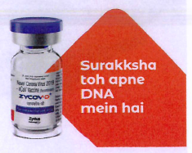
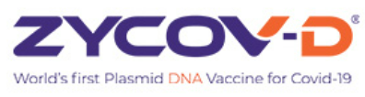
Introduction
ZyCoV-D is a DNA plasmid-based COVID-19 vaccine developed by Indian pharmaceutical company Cadila Healthcare, with support from the Biotechnology Industry Research Assistance Council (DBT-BIRAC) under Mission COVID Suraksha.
It is approved for Emergency Use Authorization (EUA) in India.
The world’s first and India’s indigenously developed Plasmid DNA Vaccine for COVID-19.
First vaccine in India to be approved for children and adults 12 years and above.

Slide 3
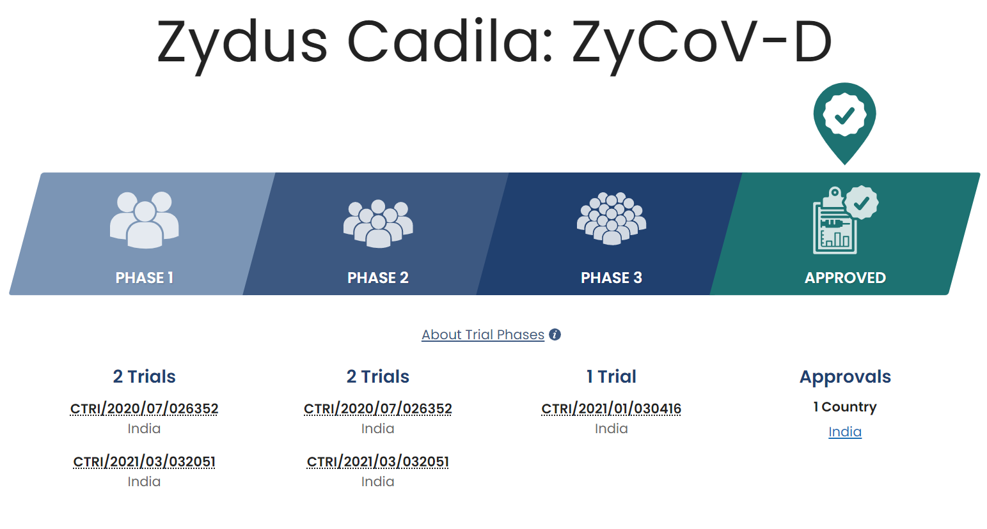
Clinical Trials

Slide 4
About the Vaccine
Description
A DNA Plasmid vector based vaccine
Product composition
Each 0.1ml contains:
DNA plasmid construct with spike protein gene region from SARS-CoV-2 virus, 1 mg produced in E.coli with Phosphate buffer saline.
Dose
Each dose consists of two shots of 0.1 ml each, given by intradermal route at two separate sites (preferably deltoid region of both the arms).
ZyCoV-D is stored at 2-8 degree’C but has shown good stability at temperatures of 25 degree C for at least three months.

Slide 5
Schedule
3 separate doses to be given at an interval of 28 days each (day 0, day 28 and day 56).
Method of Administration
ZyCoV-D® has to be given by intradermal route only using needle free injector (The PharmaJet® needle free system, Tropis®)
Contraindications
ZyCoV-D® is contraindicated in individuals known to have-
had a severe allergic reaction after a previous dose of this vaccine
had a severe allergic reaction to any ingredient of this vaccine
had a severe allergic reaction to any other vaccine

Slide 6
Special warnings and precautions for use-
As like with any other vaccines-
Hypersensitivity, Concurrent Illness, Immunocompromised individuals, Bleeding disorder or are on a blood thinner.
Duration and level of protection
Not yet well established.
Interchangeability
No data available . Concomitant administration of ZyCoV-D® with other vaccines has not been studied.

Slide 7
Use in special populations
Elderly Population:
Efficacy and safety data are currently limited in individuals ≥ 60 years of age. No dosage adjustment is required in elderly individuals ≥ 60 years of age.
Paediatric Population:
Currently limited in adolescents aged 12 to <18 years. The safety and efficacy of ZyCoV-D® in children (aged <12 years old) has not yet been established.
Fertility
No clinical data available
Pregnancy
The safety and efficacy of ZyCoV-D® in pregnancy has not been established.
Breastfeeding
The safety and efficacy of ZyCoV-D® in lactating females has not been established.

Slide 8
Risks of ZyCoV-D® vaccine
Common side effects that have been reported with ZyCoV-D® Vaccine include: Injection site redness, Muscle Pain, Injection site pain, Headache, Injection site itching, Nausea, Injection site swelling, Fatigue / Tiredness, Fever, Diarrhea etc.
These may not be all the possible side effects of ZyCoV-D® Vaccine. Serious and unexpected side effects may also occur. Still being studied in clinical trials
Reporting of side effects
Visit the nearest hospital or call the healthcare provider. Can report any side effects to Cadila Healthcare Ltd on toll free number 1800 419 1141 or visit www zyduscadila.com.
Verification of ZyCoV-D® Authenticity
Through Zydus Verify App. Each pack has a concealed secret code which comes with a scratch-able surface. The App connects the code and flashes the brand name verifying a genuine purchase.

Slide 9
Proven efficacy
66.6% overall efficacy for symptomatic COVID-19 cases.
100% efficacy for moderate COVID-19 cases.
Tested in 28,000 subjects at >5O centers across lndia.
Proven safety profile
DNA vaccines to date are not known to integrate into human genome, persist or even bio-distribute throughout the body of the vaccine recipient.
ZyCoV-D® has a better safety profile in terms of systemic and local adverse events.

Slide 10
Advantages
The thermostability of the vaccine will help in easy transportation and storage of the vaccine and reduce any cold chain breakdown challenges leading to vaccine wastage.
The plasmid DNA platform provides ease of manufacturing with minimal biosafety requirements (BSL-1). e any cold chain breakdown challenges leading to vaccine wastage.
Also being a Plasmid DNA vaccine, ZyCoV-D doesn’t have any problem associated with vector based immunity.
The Plasmid DNA platform also allows generating new constructs quickly to deal with mutations in the virus, such as those already occurring.
Needle-free technique, reducing needle-stick injuries and vaccine hesitancy induced due to fear of needles.

Slide 11
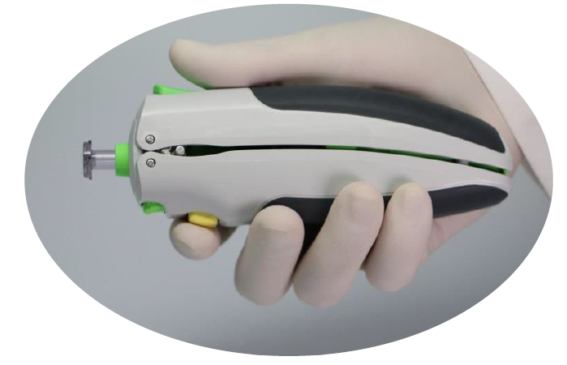
PharmaJet® Tropis®
Needle-Free Injection System
For administration of ZyCov-D Vaccine only

Slide 12
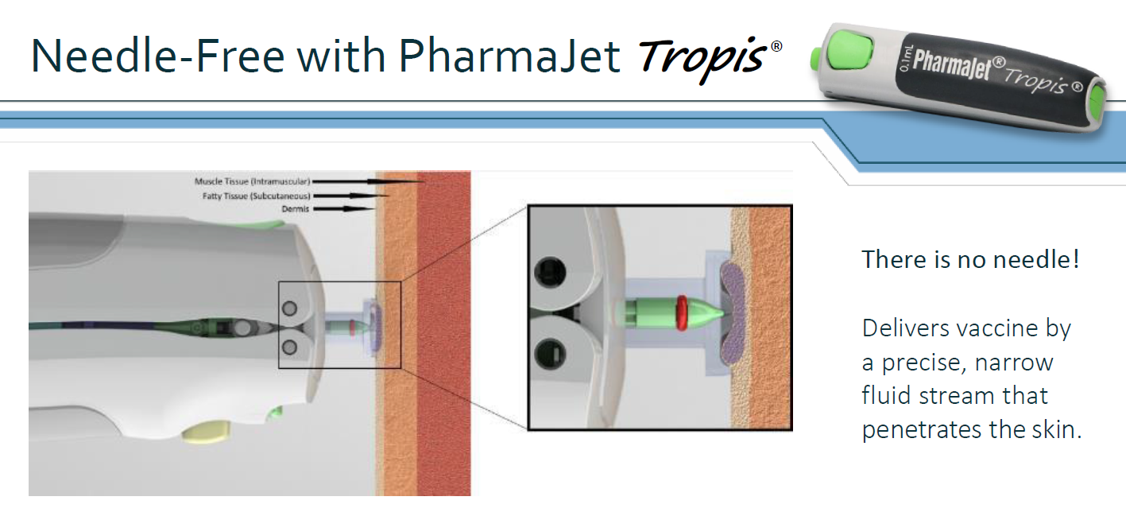

Slide 13
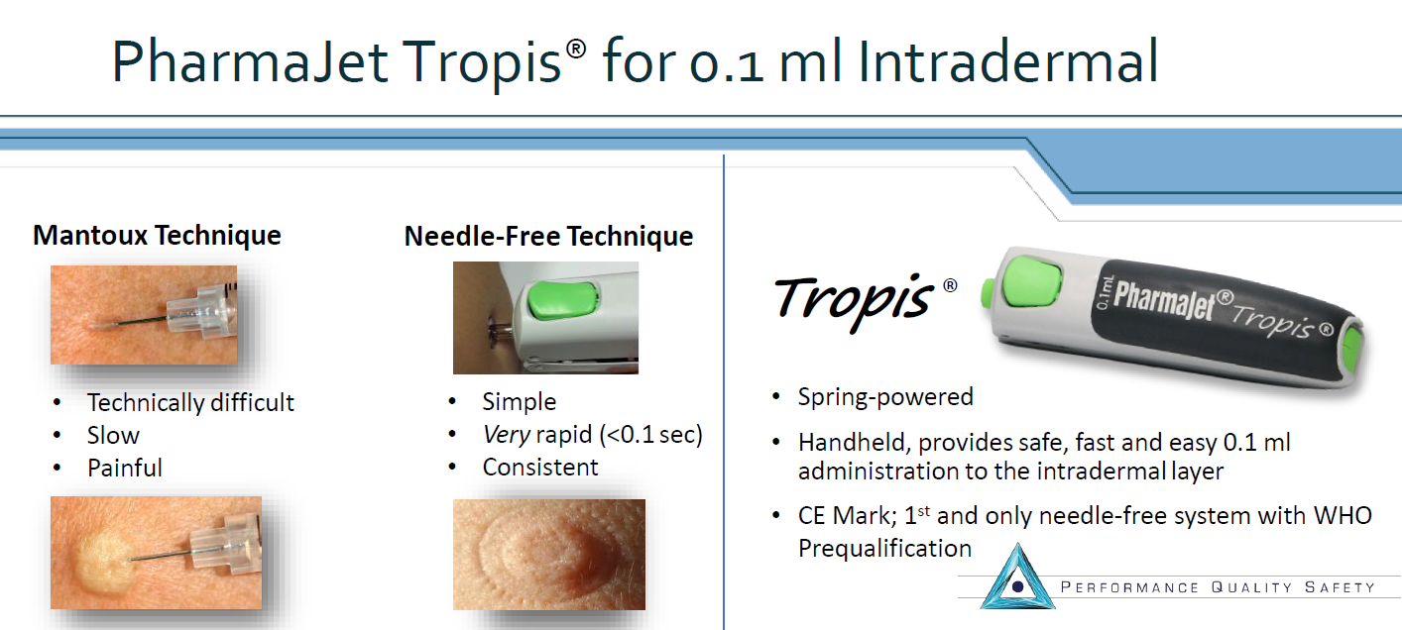

Slide 14
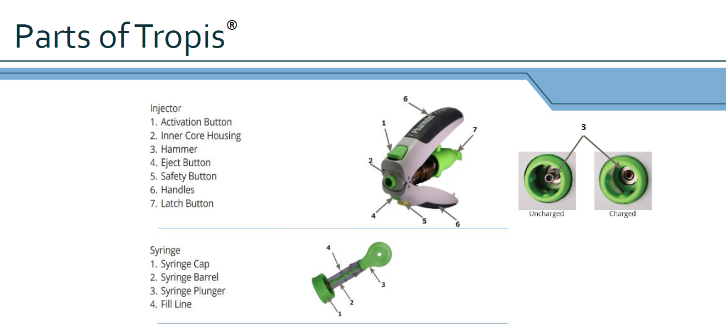
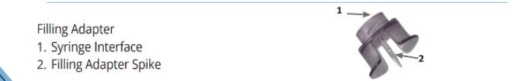

Slide 15
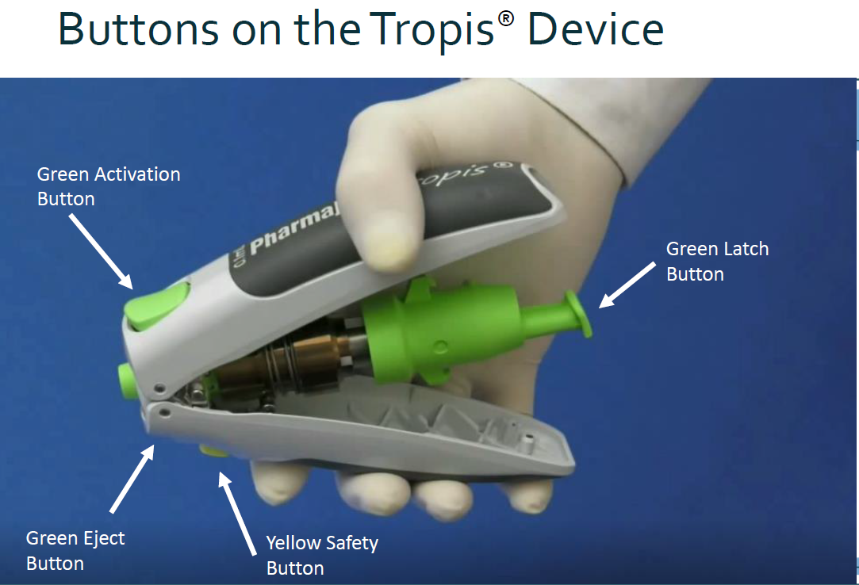

Slide 16
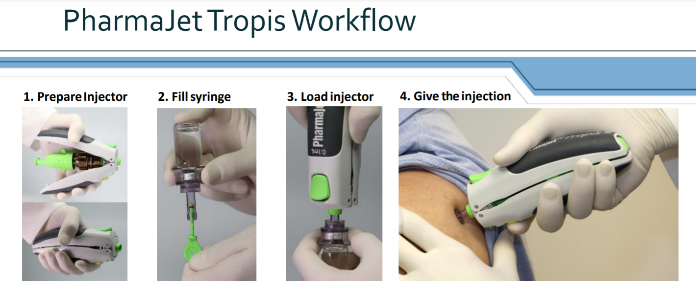
Workflow is comparable to needle-syringe. Most users are self- or web-educated within 20 minutes

Slide 17
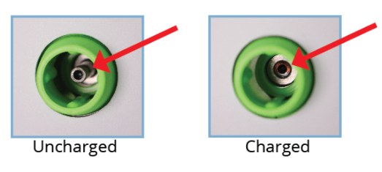
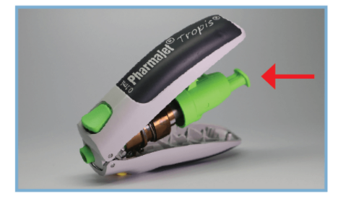
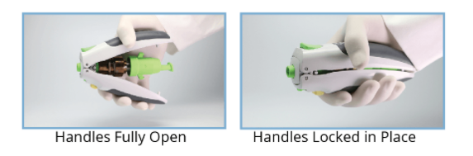
Instructions for use
1. Prepare the Injector
a. Verify the Injector is in the uncharged state, by confirming the Injector Hammer is visible.
b. When the Injector is in the uncharged state, as shown above, open the Handles to prepare the Injector. Press the rear Injector Latch Button to allow the Injector Handles to open freely.
c. With the Injector Handles fully open, squeeze the Handles until they close and are locked in place. Once the Injector Handles are closed, ensure the Injector Hammer is recessed indicating the Injector is charged.

Slide 18
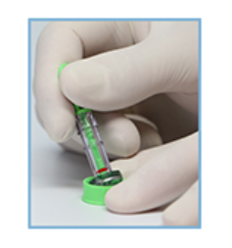
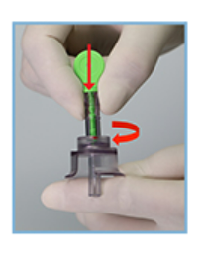
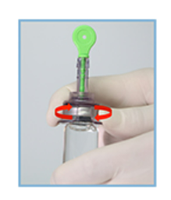
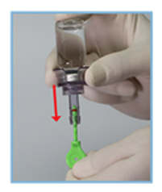
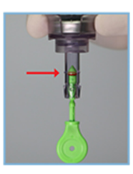
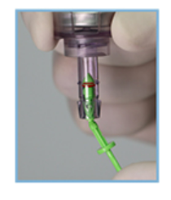
2. Fill syringe
A. Remove the green protective cap from the Syringe.
B. Place Syringe into top of Filling Adaptor. Push down and twist to lock the Syringe into place.
C. Remove the protective sleeve from the spike. Insert the Filling Adaptor spike into the vial with a twisting motion until it is fully seated
D. Invert the Adaptor/Syringe assembly. Pull down the Plunger to draw fluid into Syringe. Remove bubbles.
E. Complete filling by aligning the red rubber ring with the fill line.
F. Snap off the end of the Plunger protruding from Syringe
at the neck and discard.

Slide 19
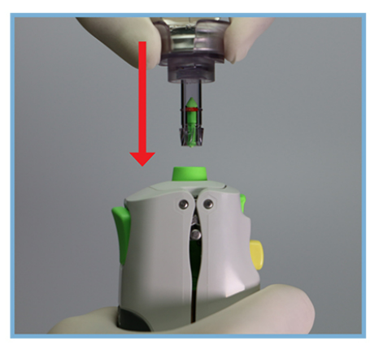
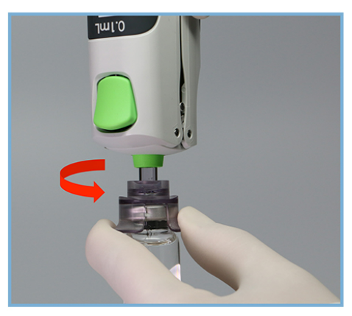
3. Load Injector
a. Insert the Syringe and Vial Assembly into the Inner Core Housing of the charged Injector until it "clicks" into place.
b. Reinvert the assembly and remove the Filling Adapter and Vial from the Syringe using a
counterclockwise turn.

Slide 20
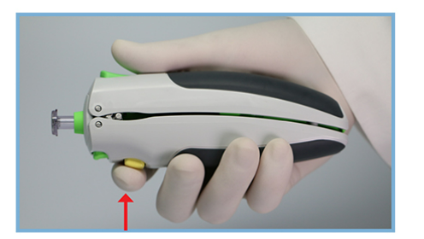
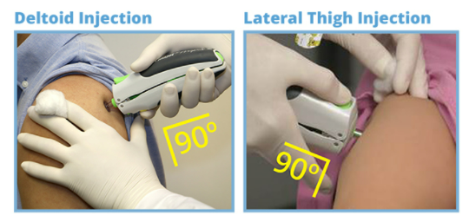
4. Give Injection
NOTE: If needed, remove protective Syringe Cap.
  a. With forefinger, depress and hold the Injector Safety Button(Yellow Button). This allows the Inner Core Housing to retract freely.
b. While holding the Safety Button, press the Syringe perpendicular to the injection site. Once the Inner Core Housing is retracted, it is not necessary to hold the Safety Button as long as you keep pressure on the patient and the Inner Core Housing remains retracted. To inject, depress Activation Button with thumb. A “click” will be heard upon injection.

Slide 21
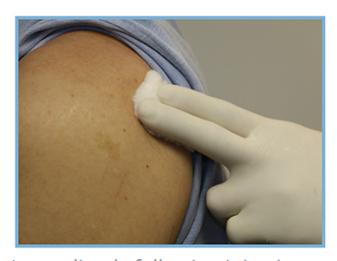
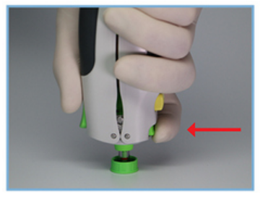
c. Immediately following injection, apply pressure to injection site with cotton or gauze for 60 seconds and then apply an adhesive bandage.
d. Remove Syringe from the Injector by pressing the Eject button, and dispose of Syringe in accordance with local requirements.

Slide 22
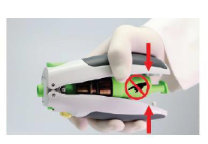
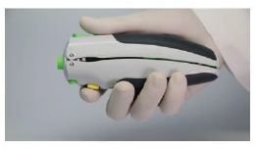
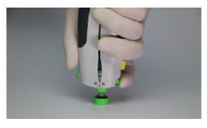
Helpful Tips

Slide 23
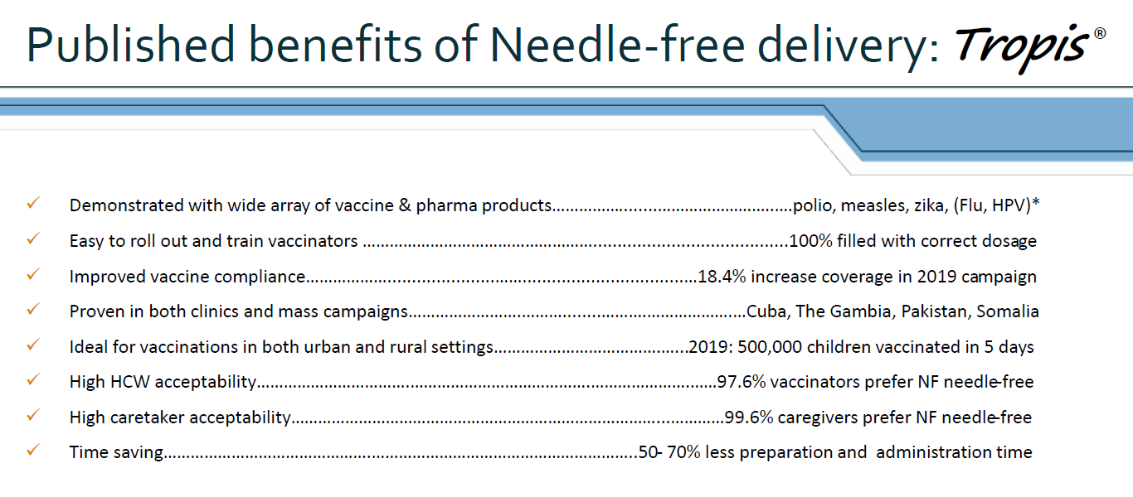

Slide 24
Frequently Asked Questions
How does pharmajet device work?
The spring powered Injector delivers the vaccine by means of a narrow, precise fluid stream, which penetrates the skin in about 1/10 of a second and gets the vaccine where it needs to be. No external power source is required.
What are the benefits of needle-free injection system- pharmajet tropis?
Needle-free technology significantly reduces patient fear and anxiety associated with getting a needle injection. It eliminates needle stick injuries to healthcare workers, greatly reduces the need for sharps disposal, eliminates needle reuse and the possibility of cross-contamination.
How many shots can be given with one device?
Pharmajet- tropis device is recommended for 20000 shots (10000 doses) of ZyCoV-D® vaccine. It's ISO certified & single device is tested for more than 30000 shots.
How to ascertain that one pharmajet device has delivered 20000 shots and till how many shots the device could be function worthy?
There is no tracker in device to know the number of shots that have been delivered. This device is mechanical pressure device and this device either works or it will not work

Slide 25
Replacement and repair of device in case of any technical issue?
Zydus will take the responsibility to replace the device asap if there is any technical issue with the device. Device damaged due to mishandling will not be replaced.
Inoculation accuracy, spillage of dose - is there any issue?
The device is tested and needle free syringe ensures the accuracy of dose with no spillage.
Storage condition for device?
Device can be kept at room temperature. Follow the storage process and guideline for any other medical device as per local recommendation.
How can we clean the device?
You can use the alcohol swab to wipe the device. Device doesn't come in contact with vaccine directly.
Would there be any impact of alcohol usage ( while wiping device/ vial top) on Vaccine efficacy?
No study has been conducted regarding impact of alcohol wipe for sterilization on ZyCoV-D®Multi-dose vaccine vial tip.
For how many days, multi dose vial of ZyCoV-D® can be used?
ZyCoV-D® vial once opened (multi-dose vials) should be used as soon as practically possible and certainly within 14 days when kept between +2°C and +8°C. All opened Multidose vials of ZyCoV-D® should be discarded at the end of immunization session or within 14 days whichever comes first.

Slide 26
How to treat discarded syringe?
As ZyCoV-D® is administered through a needle free injection System, the hub-cutter process is not required. NFIS syringe used can be directly put in the red bag.
Is the vaccine freeze sensitive? Can we freeze it?
In case of unexpected freezing of vaccine at 2-8°C storage, it can be administered after thawing.
What if the electricity issue & Cold-chain of 2-8 degree storage is not maintained?
It is recommended to store ZyCoV-D® at 2° to 8°C. However our developmental studies have shown that it is stable for up to 3 month at 25 deg C.
Is there any VVM on vial?
No as per MOHFW Covid-19 operational guidelines 7.2.1, there will be no WM on the vial. Cold chain management for the all vaccine is the prime importance by the vaccination site supervisor.
Can alternative route of ID needle be used?
No, ZyCoV-D® has to be given by intradermal route only using needle free injector (pharmajet tropis device).
Is there any study on cost of device versus standard ID route?
No, there is no study conducted till date. But feasibility study conducted on NFIS device in IPV in pakistan show better acceptability of NFIS among care givers with 0% vaccine loss

Slide 27
Can adaptor be re-used for multiple vials?
1filling adaptor is recommended to be used for only 1 multi-dose vial for 10 dose (20 shots) of ZyCoV-D®. There are chances of contamination during the process of re-use. Therefore, it is not recommended to use the filling adaptor for more than one multi-dose vials
Will there be any issue of in filling syringe if vacuum is developed after few dosage?
As per process the vial has to be inverted to drive the vaccine in syringe. Chances of vacuum to be developed through filling adaptor in syringe are negligible. If vacuum is developed re-do the entire process.

Slide 28
References
http://zycovd.co.in
http://zycovd.co.in/needle-free-injector-system/medication-guide-video/
Prescribing Information & Fact sheet of ZyCoV-D®
https://pib.gov.in/PressReleasePage.aspx?PRID=1747669
http://www.pharmajet.com/

Slide 29
Thank You!
Reaching Impact, Saturation, and Epidemic Control (RISE)

